Slide 1
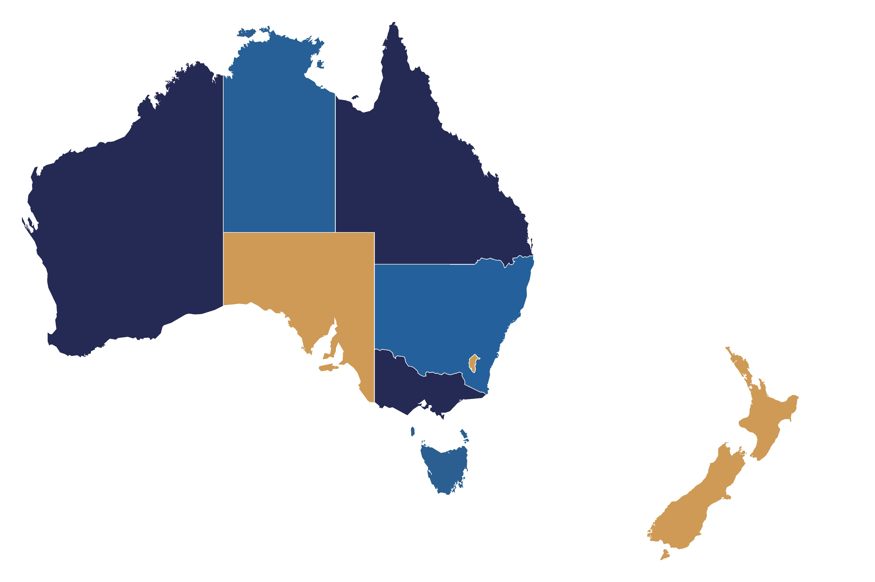
Trauma verification sites
as of June 2025
NORTHERN TERRITORY
Royal Darwin Hospital
Alice Springs Hospital
Katherine Hospital
Gove District Hospital
Tennant Creek
QUEENSLAND
Queensland Children’s Hospital*
Gold Coast University Hospital
Australian Army – 2nd General Health Battalion
Townsville Hospital
Mackay Base Hospital
Rockhampton Hospital
Nambour Hospital
Royal Brisbane Women’s Hospital
Princess Alexandra Hospital
NEW SOUTH WALES
Liverpool Hospital
John Hunter Hospital
Westmead Hospital
Royal North Shore Hospital
St George Hospital
St Vincent’s Hospital
Children’s Hospital at Westmead
Sydney Children’s Hospital
Royal Prince Alfred Hospital
Wollongong Hospital
Tamworth Hospital
Port Macquarie Base Hospital
Coffs Harbour Health Campus
Lismore Base Hospital
Tweed Base Hospital
Orange Base Hospital
Dubbo Base Hospital
Nepean Hospital
Wagga Wagga Hospital
Gosford Hospital
WESTERN AUSTRALIA
Royal Perth Hospital
Fremantle Hospital
Sir Charles Gairdner Hospital
Princess Margaret Hospital for Children
AUSTRALIAN CAPITAL TERRITORY
Canberra Hospital
SOUTH AUSTRALIA
Royal Adelaide Hospital
Flinders Medical Centre
Women’s and Children’s Hospital
Lyell McEwin Hospital
South Australian Trauma System
VICTORIA
The Alfred Hospital
Royal Melbourne Hospital
TASMANIA
Royal Hobart Hospital
NEW ZEALAND
Waikato Hospital
Starship Children’s Hospital
Taranaki Base Hospital
Rotorua Hospital
Tauranga Hospital
Gisborne Hospital
Whakatane Hospital
New Zealand System Review
Sites in bold hold current verification status
Sites in red are trauma systems
*Formerly Royal Children’s Hospital and Mater Children’s Hospital, and Lady Cilento Children’s Hospital

