Slide 1

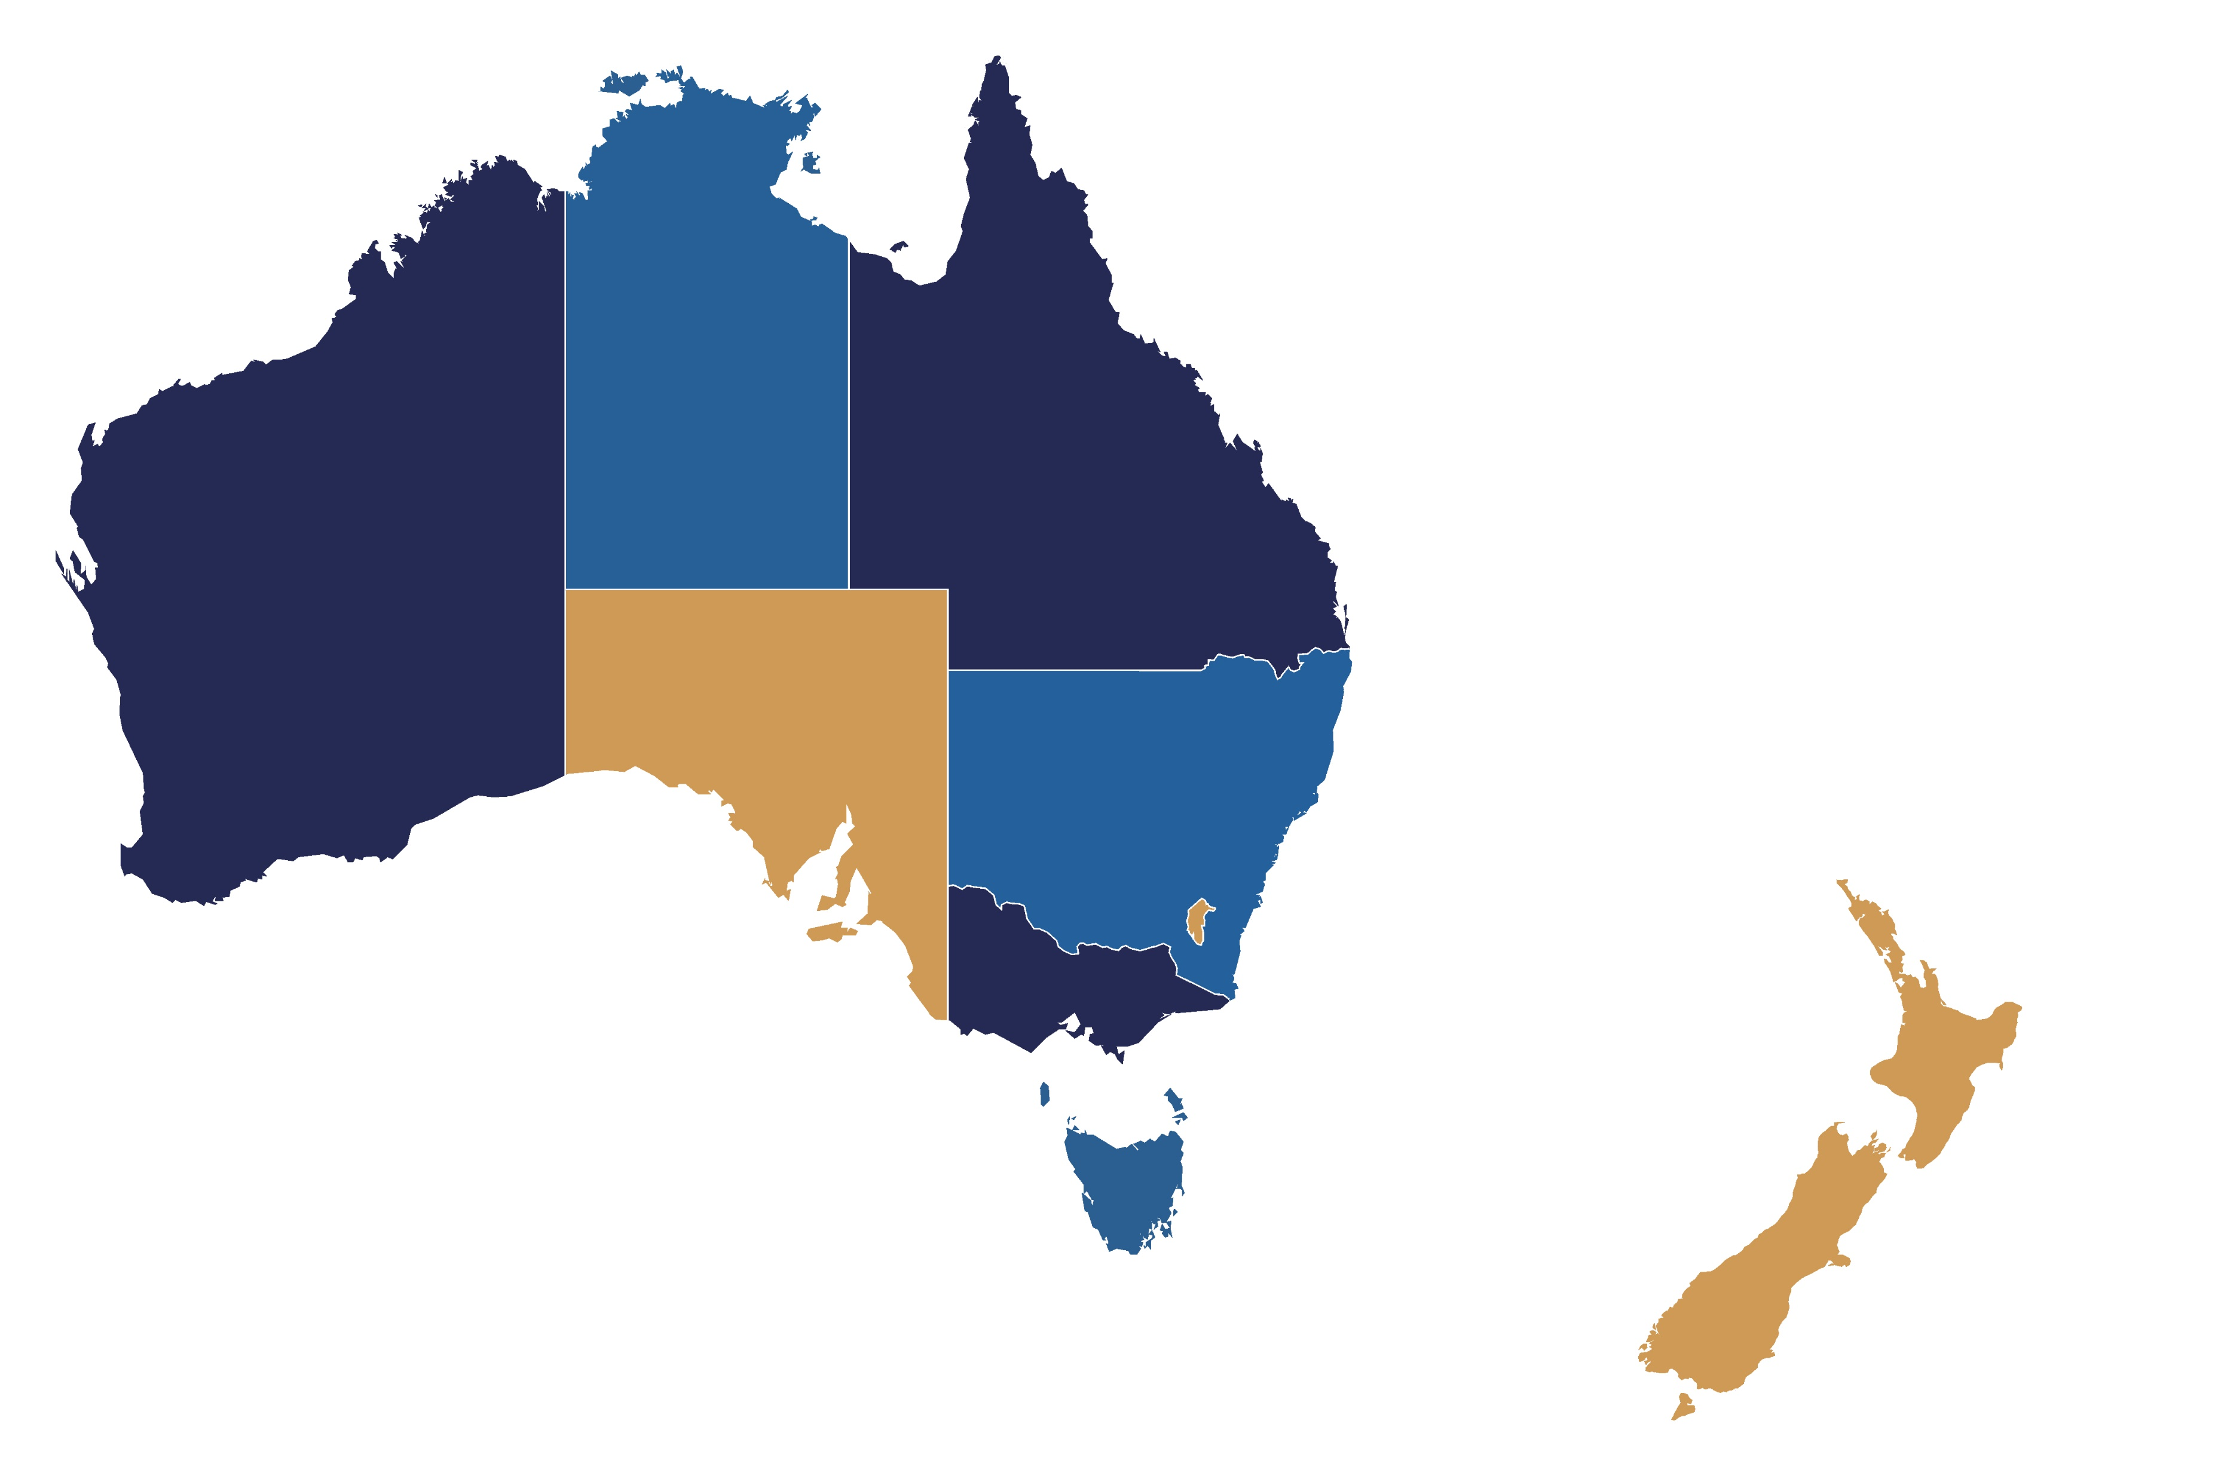
Trauma verification sites
as of March 2022
NORTHERN TERRITORY
Royal Darwin Hospital
Alice Springs Hospital
Katherine Hospital
Gove District Hospital
Tennant Creek
QUEENSLAND
Queensland Children’s Hospital*
Gold Coast University Hospital
Australian Army – 2nd General Health Battalion
Townsville Hospital
Mackay Base Hospital
Rockhampton Hospital
Nambour Hospital
Royal Brisbane Women’s Hospital
Princess Alexandra Hospital
NEW SOUTH WALES
Liverpool Hospital
John Hunter Hospital
Westmead Hospital
Royal North Shore
St George Hospital
St Vincent’s Hospital
Children’s Hospital at Westmead
Royal Prince Alfred Hospital
Wollongong Hospital
Tamworth Hospital
WESTERN AUSTRALIA
Royal Perth Hospital
Fremantle Hospital
Sir Charles Gairdner Hospital
Princess Margaret Hospital for Children
AUSTRALIAN CAPITAL TERRITORY
Canberra Hospital
SOUTH AUSTRALIA
Royal Adelaide Hospital
VICTORIA
The Alfred Hospital
Royal Melbourne Hospital
TASMANIA
Royal Hobart Hospital
NEW ZEALAND
Waikato Hospital
Starship Children’s Hospital
Taranaki Base Hospital
Rotorua Hospital
Tauranga Hospital
Gisborne Hospital
Whakatane Hospital
New Zealand System Review
Sites in bold hold current verification status
Sites in red are verified trauma systems
*Formerly Royal Children’s Hospital and Mater Children’s Hospital, and Lady Cilento Children’s Hospital

