Slide 1
Fellowship Examination Webinar:
Your Questions Answered

Slide 2

Acknowledgement of Country
Māori Welcome
RACS acknowledges the Aboriginal and Torres Strait Islander people as the traditional owners of the land that we are all on today and extend our respect to elders past, present and emerging.
RACS respects Ngā Iwi Māori as the Tangata Whenua of Aotearoa and is committed to upholding the principles of Te Tiriti o Waitangi, fostering the College’s relationship with Māori, supporting Māori Fellows and Trainees, and striving to improve the health of Māori.
Notes:
RACS acknowledges the Aboriginal and Torres Strait Islander people as the traditional owners of the land that we are all on today and extend our respect to elders past, present and emerging.
RACS respects Ngā Iwi Māori as the Tangata Whenua of Aotearoa and is committed to upholding the principles of Te Tiriti o Waitangi, fostering the College’s relationship with Māori, supporting Māori Fellows and Trainees, and striving to improve the health of Māori.

Slide 3

Panelists:
Adjunct Professor Deborah Bailey
Chair, Court of Examiners
Dr Gregory Keogh
Deputy Chair, Court of Examiners
Dr Glen Wood
Deputy Chair, Court of Examiners
Mishie Juganaikloo
Manager, Fellowship Examination
Ryan Frerotte
Examinations Coordinator
Desley Ward
General Manager, Assessments

Slide 4
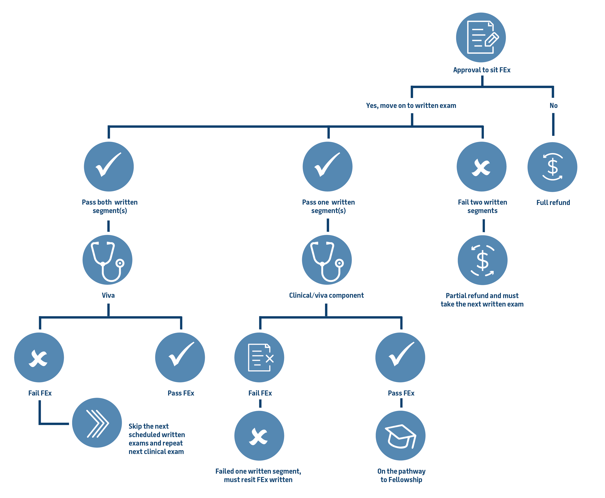
FEx | Uncoupling of the Fellowship Examination (excluding Vascular Surgery)

Slide 5
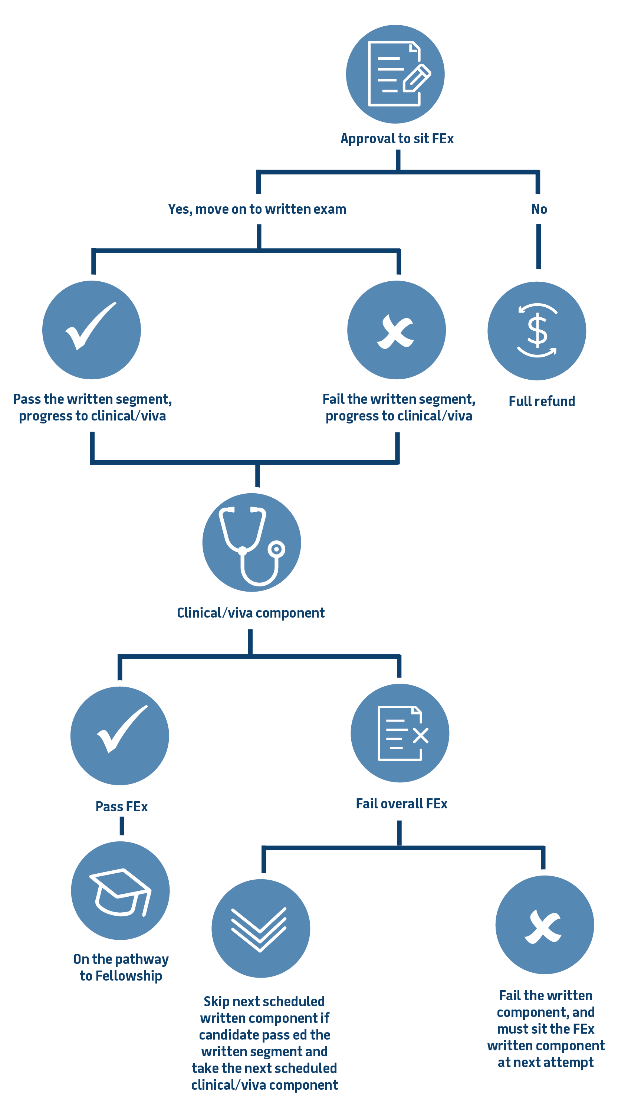
FEx | Uncoupling of the Fellowship Examination for Vascular Surgery
As Vascular Surgery has one written segment, all candidates will progress to the clinical/viva component whether they passed or fail that segment.

Slide 6
FEx | Uncoupling of the Exam
Candidates who fail two written segments will not progress to the clinical/viva component in that sitting. For Vascular Surgery as the written component consists of only one segment, all candidates who fail the written segment will progress to the clinical/viva component.
Candidates who pass all written segments but fail the overall exam will bypass the written component of the next scheduled exam sitting as a one-time exemption and progress directly to the clinical/viva component.
Candidates who do not progress to the clinical/viva component will receive a partial refund of the examination fee after the conclusion of the clinical/viva examination in accordance with the information published on the RACS website.
Candidates who are only required to sit the clinical/viva component will pay a reduced examination fee, refer to the information published on the RACS website.
Candidates who cannot attend the next sitting of the clinical/viva component on medical grounds must contact the exams department via email so that their circumstances and supporting documents can be evaluated on a case-by-case basis.
Candidates will be notified via email regarding their progression to the clinical/viva component approximately two weeks prior to the scheduled start date of the first clinical/viva segment.

Slide 7
FEx | Written Examination
Registration
    Registration required for both AM and PM sessions
    Candidates are to present their pre-approved reasonable adjustment letter at the time of registration
    Candidate will be provided with an ID badge upon registration – purple for the morning and green for the afternoon.
    Candidates to place electronic devices such as Phone and watches into the envelope
    Larger items such as laptops or larger electronic devices must be switched off and be placed inside the candidate’s bag
Forms of Identification
    Photo ID – Driver’s Licence / Passport / Hospital ID / Digital ID
    Candidates who do not have appropriate identification must complete Declaration of Identification Form
Mobile phones and smart/analogue watches
    Must be turned off and surrendered at registration, including analogue watches
    Mobile phones can be returned to candidates for use during the break between the two examination sessions
Late Arrivals
    Permitted to start up to 30 minutes after scheduled start
    No additional time provided if arriving late

Slide 8
FEx | Written Examination
    PC Issues
    If you encounter any issues with your PC, please inform the invigilator immediately, and you will be relocated to another PC. Any time lost between the issue reported/logged and the re-start of the exam will be compensated.
    Prohibited items in the exam rooms
    All electronic items, all watches (analogue or smart watches), headphones and calculators​
    Personal earplugs​
    Pencil cases / spectacle cases ​
    Any device capable of recording audio or visual material i.e., smart glasses
    Food & drink (except water) is not allowed – unless medical reason and approved by RACS​
    White-out liquid/tape​

Slide 9
FEx | Clinical/Viva Examination
Registration on Arrival
It is recommended to arrive 10-15 minutes before your segment begins to complete registration and hear any announcements from the Senior Examiner and/or RACS Staff.
Signage and marshals will be at various points in the hospital/venue to provide direction to the examination area.
Please bring photo ID (e.g. passport, driving license, hospital ID, digital ID etc.).
You'll receive your candidate number badge upon registering for your first Clinical/Viva segment. It's essential to wear this badge throughout every segment. If you lose or forget the candidate badge, please notify either the Local Coordinator or the Examinations Department.
At registration, all mobile phones, watches (smart and analogue), timers and other electronic devices (including audio-recording devices) will be collected and securely stored during the examination. These will be returned when you leave the post-examination waiting area.

Slide 10
FEx | Clinical/Viva Examination
Quarantine post-examination
Depending on your position in the segment’s rotation of candidates, you may be required to remain in a quarantine area until the last rotation of candidates begins the examination.
Water and biscuits are provided in the pre and post examination areas, but you are welcome to bring your own food should you wish.
You not have access to electronic devices/watches during the quarantine period.
If you need to use the bathroom during this time, you will be escorted by a marshal.

Slide 11
FEx | Clinical/Viva Examination
Observers
You may have an observer in the examination room during the examination. An observer may be:
    A Court of Examiners Executive member or a Senior Examiner;
    A newly appointed examiner;
    An examiner from another specialty or a Fellow of RACS;
    Other observers as appointed by the Chair of the Court of Examiners, or
    A representative from training board/committee, i.e., supervisor, Chair etc…
The new examiners attend for training and other observers to ensure the reliability, validity and fairness of the examination process.
Observers do not have any input into the candidate’s assessment or mark for the segment.
Conflict of Interest
As a rule of thumb, a conflict of interest may exist where a candidate has worked with an examiner or has maintained a correspondence or other contact over an extended period.
There are a range of circumstances that can lead to a conflict of interest and potentially compromise the independence of the examination, in fact or in perception.
Candidates are advised to check the list of examiners on the college website regarding any potential conflicts of interest they may have with examiners of both the written and clinical/viva components of the Fellowship Exam.

Slide 12
FEx | FAQs
Q – When will the timetables for the Clinical/Viva be sent?
A – The provisional timetable clinical/viva venues for the September will be sent after the written exams.
Q – When will the results be released?
A - The results will be released to candidates Monday 22 September 2025.
Q – How long is the reading time for the written exams?
A – There is no reading time, candidates may start as soon as instructed.
Q – Will we have pen and paper to jot ideas?
A – Pens and scribble paper will be provided. These must be left in the room at the conclusion of the exams.
Q – Will we be allowed toilet breaks during the written exams?
A – If a toilet break is required during the examination, candidates must raise their hand to alert the invigilator, and candidates will be escorted to the bathroom.
NB: Toilet breaks are not permitted in the first 30 minutes or the last 30 minutes of the examination.
Q – What if I have a question about the written exams?
A – Candidates who have question about the exams are required to submit an inquiry form, which will be available from the invigilators.

Slide 13
FEx | FAQs
Q – What can I bring to the exam rooms for the written exams?
A – If you are doing a computer-based exam, you do not need to bring anything.
A – If you are sitting a paper-based exam, pens will be provided. If you bring your own pen, it will need to be inspected at registration.
Q – Can I register earlier than my allocated time for the written exams?
A – You will not be able to register early, please only arrive at the designated time.
Q – What if my RACS ID and/or Password does not allow me to log in?
A – Please try to type your RACS ID and the password provided on your desk slowly (take your time). You must advise the invigilator immediately if this does not work.
Q – Can I leave early if I finish my exam?
A – Candidates are not permitted to leave the examination room early, except in case of illness.
Q – Can certain symbols be used in our answers (i.e. ‘>’ instead of typing out ‘larger than, or greater than’)?
A – Yes, using symbols like '>' instead of typing out 'larger than' or 'greater than' is acceptable if the symbols are appropriate for the context of the question/answer.
Q - Is it acceptable to use abbreviations in your answers?
A – Abbreviations are acceptable if they are widely understood/used within your specialty.
Any other questions, please raise your hands or write your questions in the chat.

Slide 14
FEx | Questions from candidates
Q – Are laptops permitted during the quarantine period?
A – Candidates will not have access to any electronic devices during the quarantine period.
Q – When is the exact location of the Clinical/Viva provided, so candidates can make accommodation arrangements?
A – The Fellowship Examination Team will advise candidates of the provisional venues on Friday 1 August.
Q – For essay questions, is point-form writing with prose elaboration permitted particularly when the prompt requests a list or multiple items?
A – Yes, point-form writing accompanied by prose elaboration is permitted for essay questions, particularly when the prompt requests a list or multiple elements.
Q – Does the pre-approved reasonable adjustment letter refer to the email sent by the examination team?
A – Candidates who applied for reasonable adjustment have been sent their letter confirming the arrangements. The letter must be provided for all applicable examination registration.
Q – How is marking handled for written exams that include two sections within a single paper, such as an essay and ISAWEs?
A – Please refer to the Notes to Candidates on the Fellowship Examination webpage.
Q – Will the exam room have a clock for the Written Exam?
A – There will be a clock in every exam room.

Slide 15
FEx | Questions from candidates
Q – Do candidates receive results for both written sections before the clinical/viva, or are they simply notified of eligibility to sit the clinical/viva?
A – Candidates are only advised whether they progress to the clinical/viva component or not.
Q – For the Written exam (computer-based exam), can responses submitted earlier be reviewed and edited at any point during the exam?
A – Yes, candidates can amend their responses during the exams.
Q – Will the cut/copy/paste functions be available in the text boxes during the written exam?
A – Yes, the cut/copy/paste functions be available for the written examination.
Q – When will candidates be notified of their progression to the clinical/viva component?
A – Candidates will be advised in writing on Thursday 4 September 2025.

Slide 16
Thank you for your time.
Examination Team Contact
E: examinations@surgeons.org
T: +613 9249 1280

