Slide 1
Category 4 RACS CPD Reflective Practice
Sally Langley
October 2018

Slide 2
RACS Competencies
Notes:
Continuing Professional Development should encompass all of the 9 RACS competencies. Many of us focus on medical and technical expertise.

Slide 3
RACS CPD - Portfolio
Notes:
To access your RACS CPD you need to go go online to your Portfolio. You should regularly look at your Portfolio page and study the components of it.

Slide 4
Notes:
RACS general statement.

Slide 5
Notes:
Either via the RACS Portfolio, website or the printed version, you can review CPD requirements.

Slide 6
RACS CPD
Notes:
Fellows can participate in an alternative approved CPD programme eg orthopaedics
We are currently reviewing the CPD framework, a workshop was held in September 2018.
Note that it is a requirement for MBA and MCNZ to comply with CPD programme. This cannot be falsified.
Note that this is a regularity requirement for MCNZ and AHPRA.

Slide 7
Aims of RACS CPD Programme
Notes:
There are the 3 aims of RACS CPD programme.

Slide 8
RACS CPD
Notes:
Key change to CPD – Reflective Practice component added, Category 4. In 2017 the e-Learning OWR sufficed.

Slide 9
RACS CPD

Slide 10
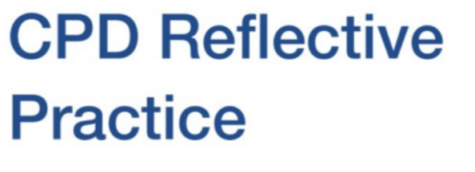
RACS CPD

Slide 11
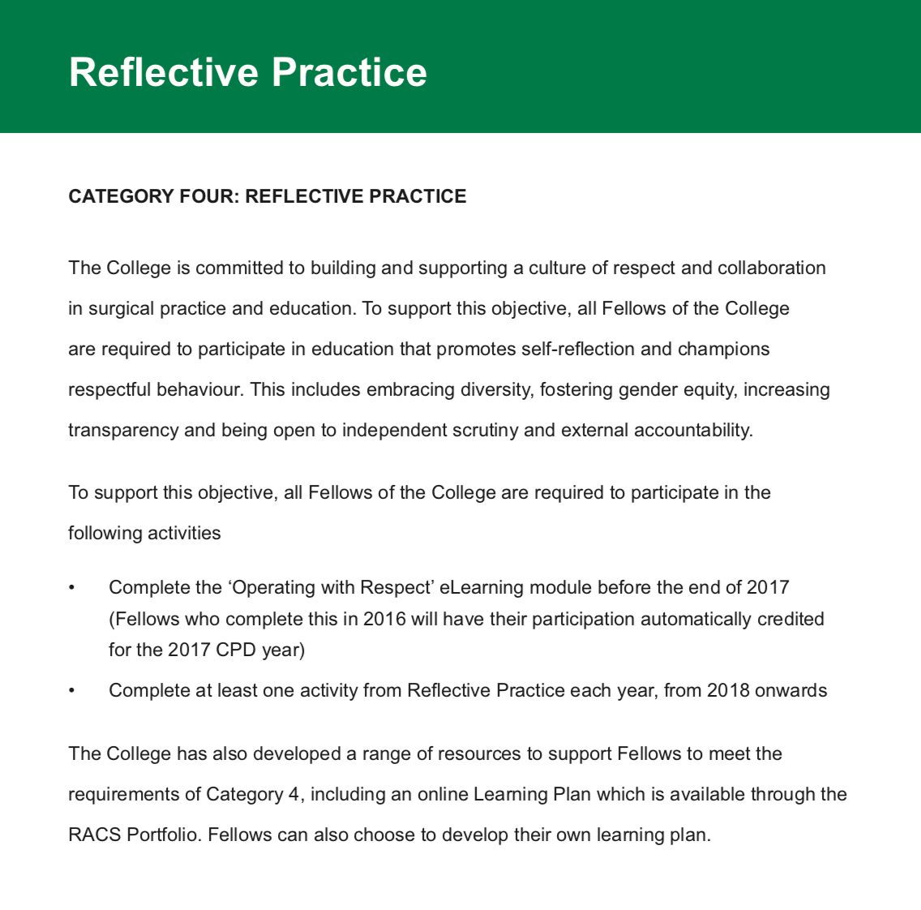
Notes:
Category 4, Reflective Practice

Slide 12
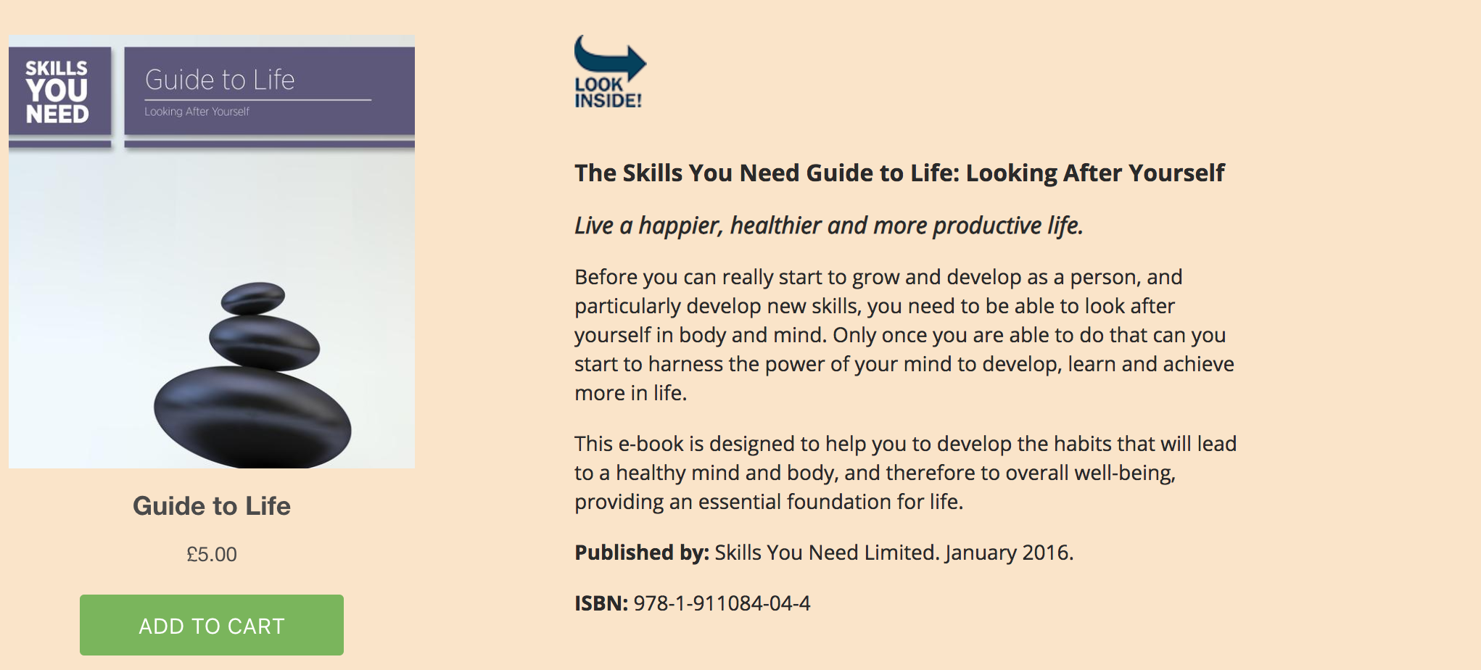
What is Reflective Practice?
Notes:
“skillsyouneed” on Google!

Slide 13
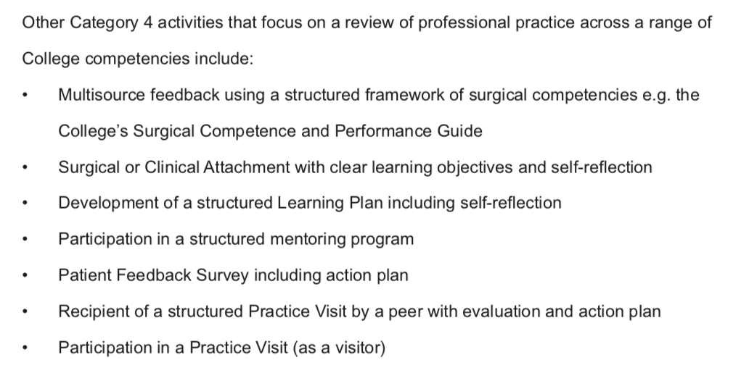

Slide 14
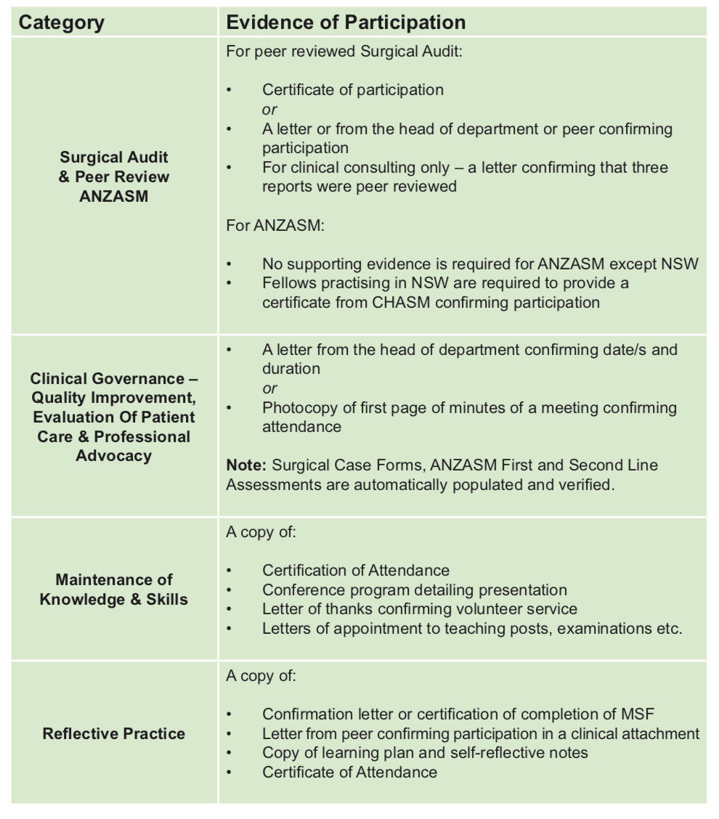
Notes:
You will need to provide evidence of your reflective practice eg certificate for cultural competency course; page of written notes for Learning Plan.

Slide 15
Notes:
Evidence of Participation

Slide 17
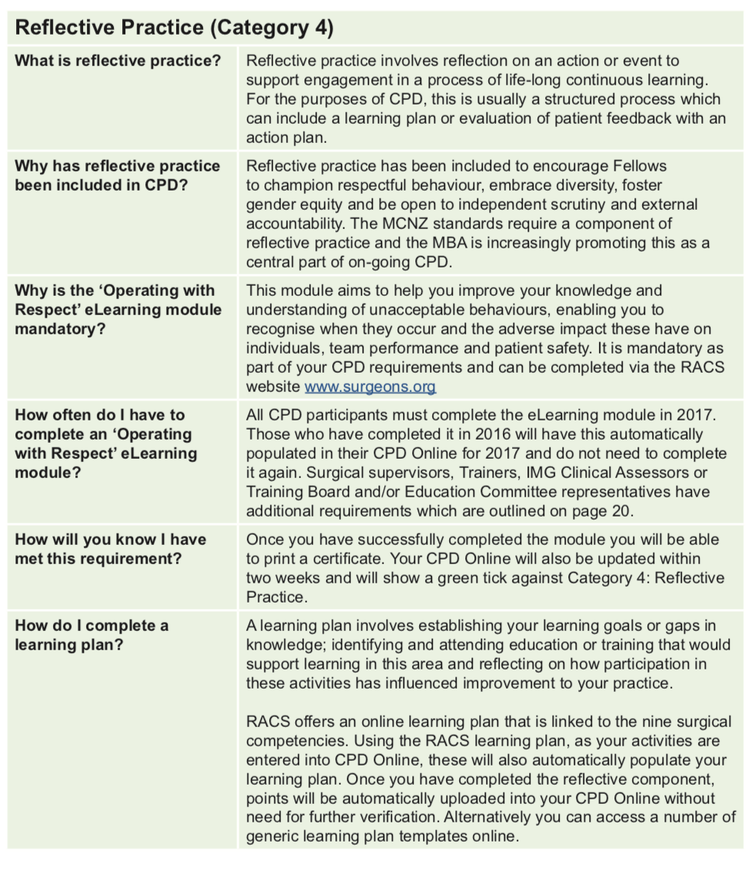
Notes:
A good self reflective way to comply is to do a Learning Plan. You can access this via myCPD on your RACS Portfolio. Basically a Learning Plan is documentation of your thought process around a topic of interest for the year. The plan, the action, your thoughts afterwards.

Slide 18
Notes:
Via myCPD on Portfolio.

Slide 19
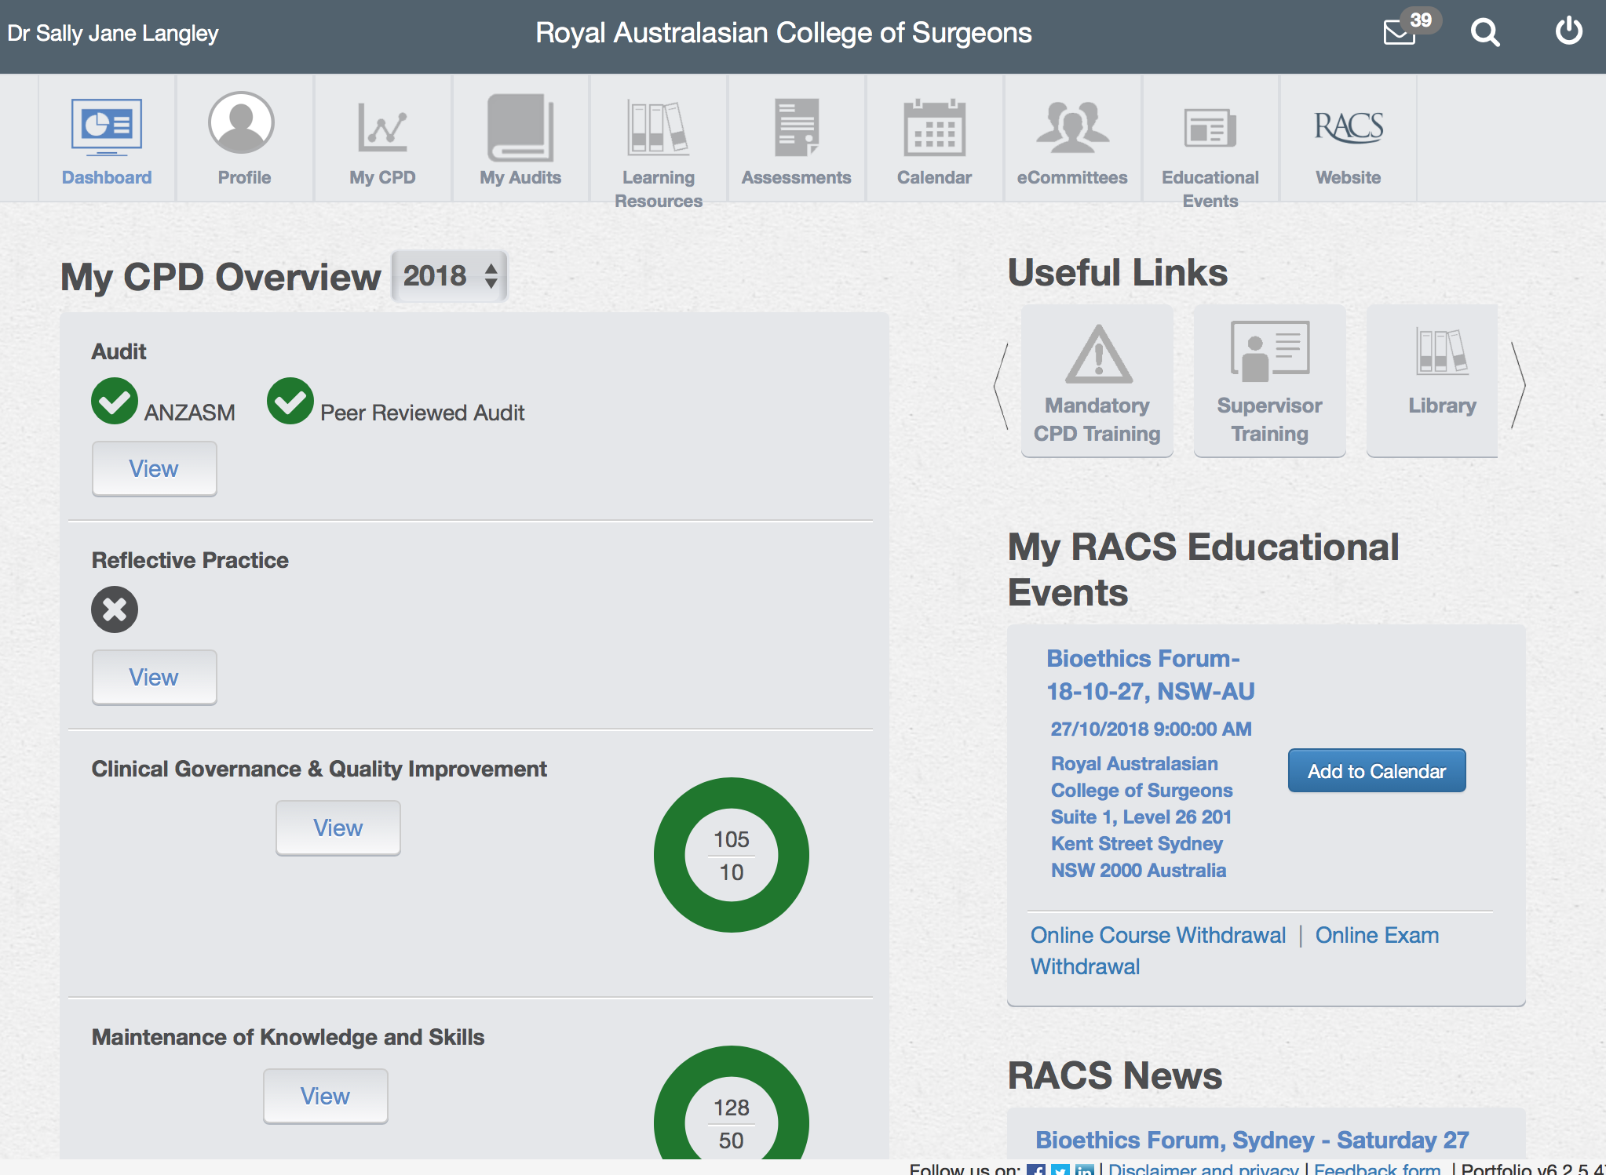

Slide 21
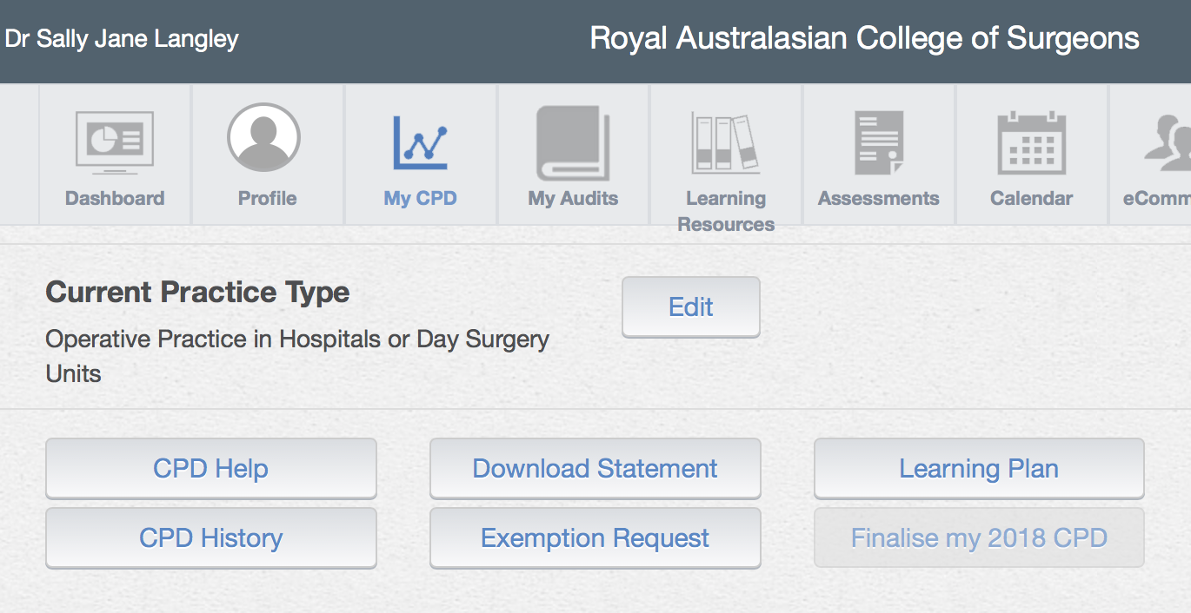

Slide 23
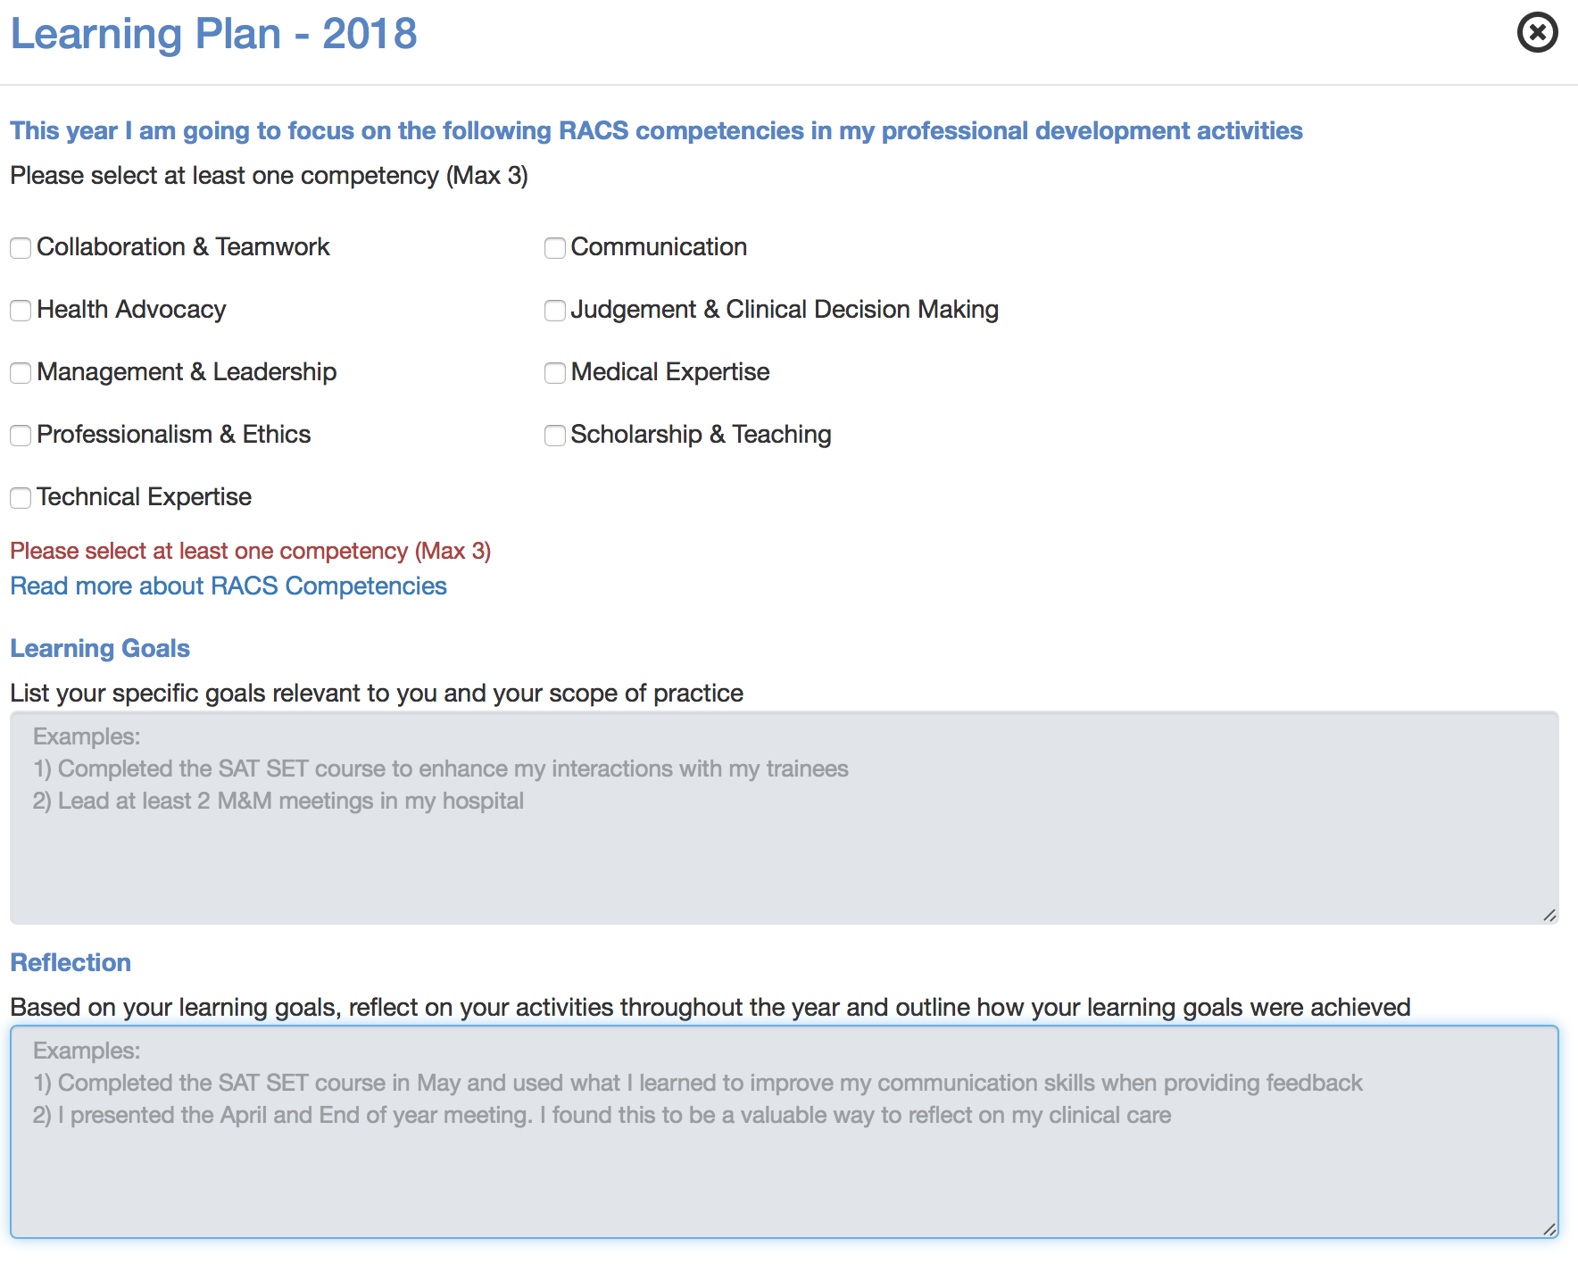

Slide 24
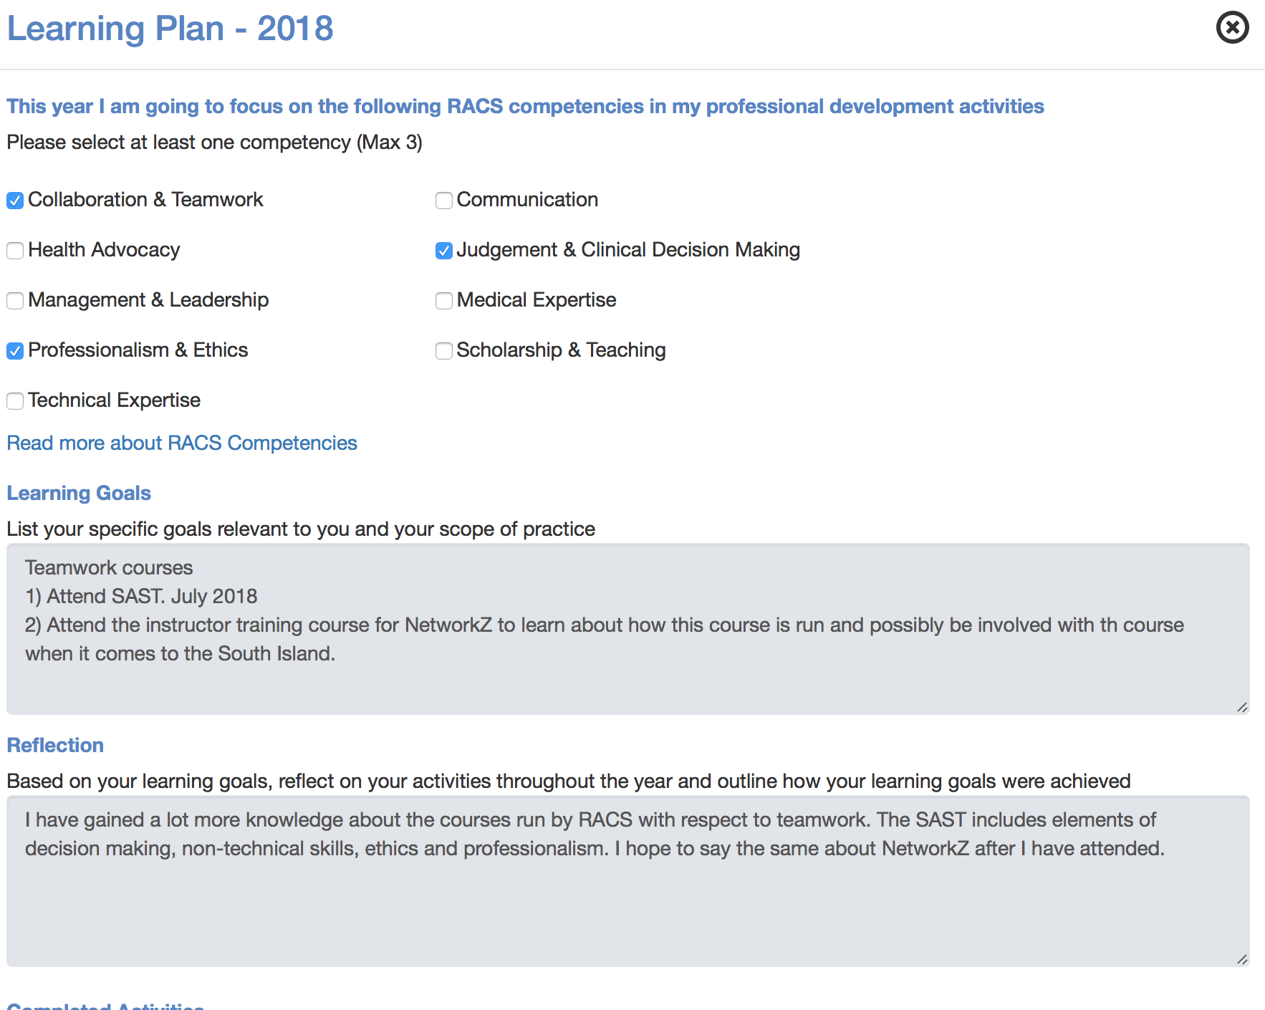
Notes:
Example 1 SJL

Slide 25
Notes:
Example 2 SJL

Slide 26
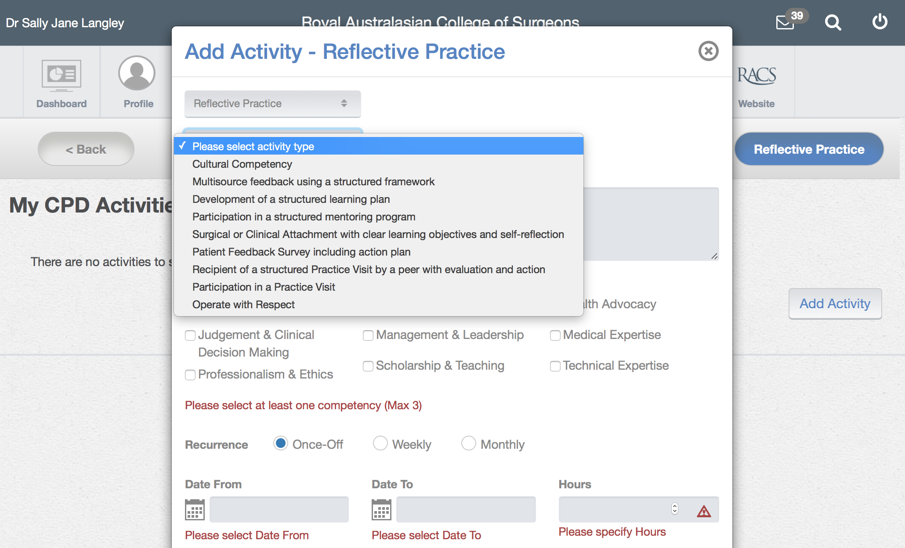

Slide 27
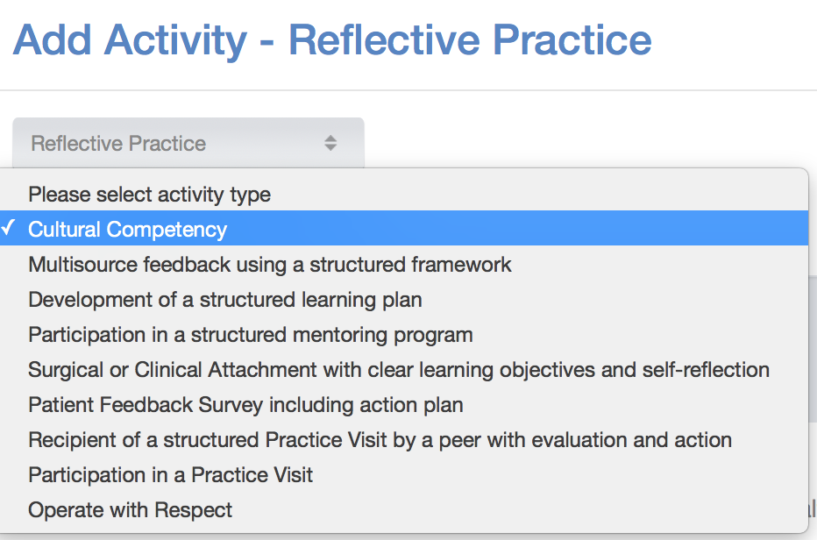
Notes:
A cultural competency course is another good way to achieve Reflective Practice compliance.

Slide 28
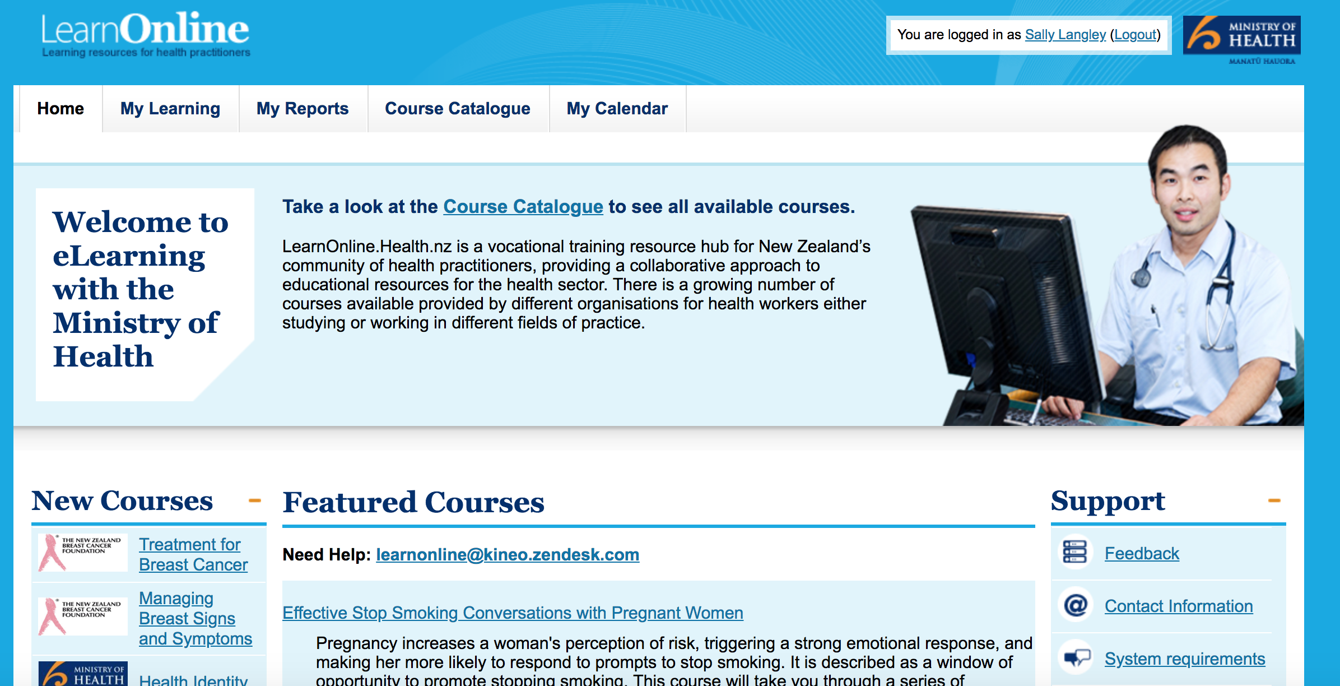
Notes:
You can either do the RACS cultural competency online eLearning or in NZ, the Ministry of Health. They are slightly different so you might wish to do both for an extended experience. You could do the whole course in on sitting which wold take about 2 hours, or plan to do 20 minutes per day/night for a week or two, or weekly. That way the completion of the course and learning from it can be achieved.
To access the MOH course you need to register as a user and in fact you will have access to a numbe rof other courses of interest.

Slide 29
Notes:
MOH

Slide 31
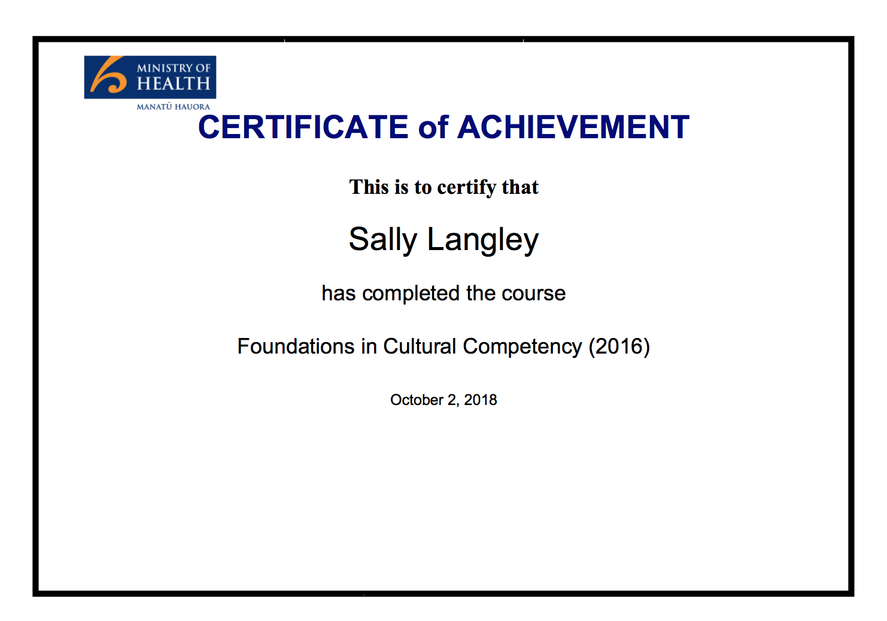
Notes:
The MOH cultural competency course is helpful.

Slide 32
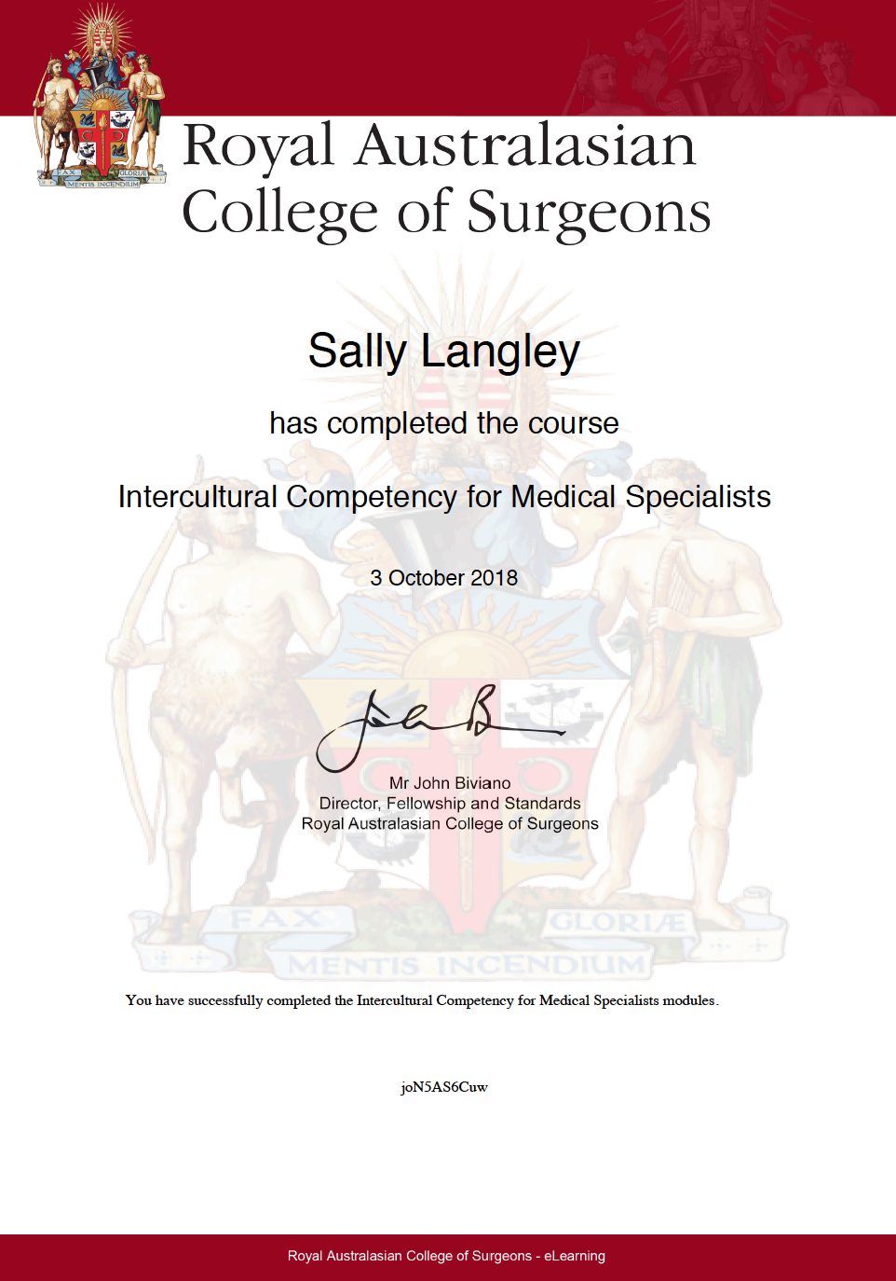
Notes:
The RACS cultural competency has a lot about communication styles. It takes about 2 hours. You could take longer.

Slide 33
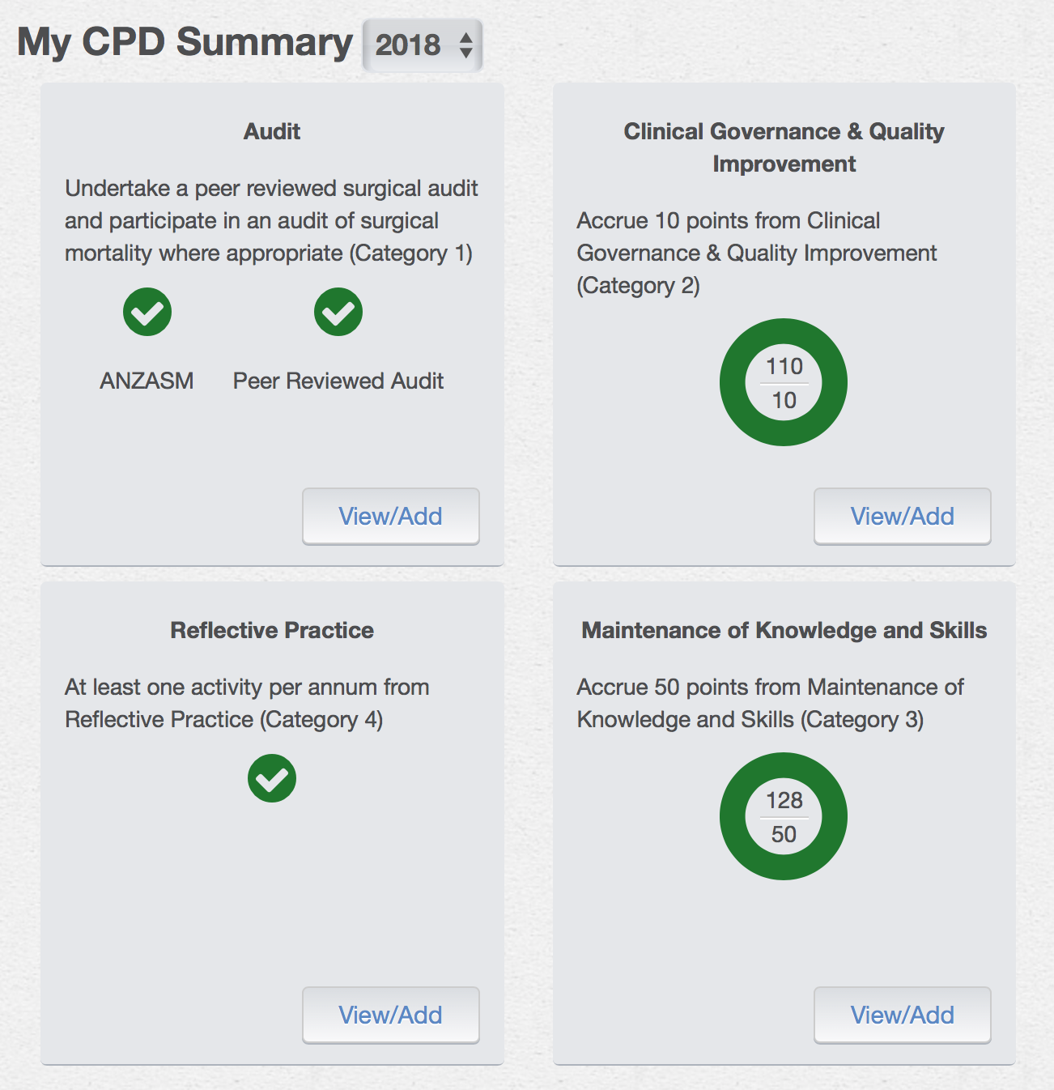
Notes:
Once completed and entered in your category 4, you have complied with Reflective Practice and get a green tick!

Slide 34
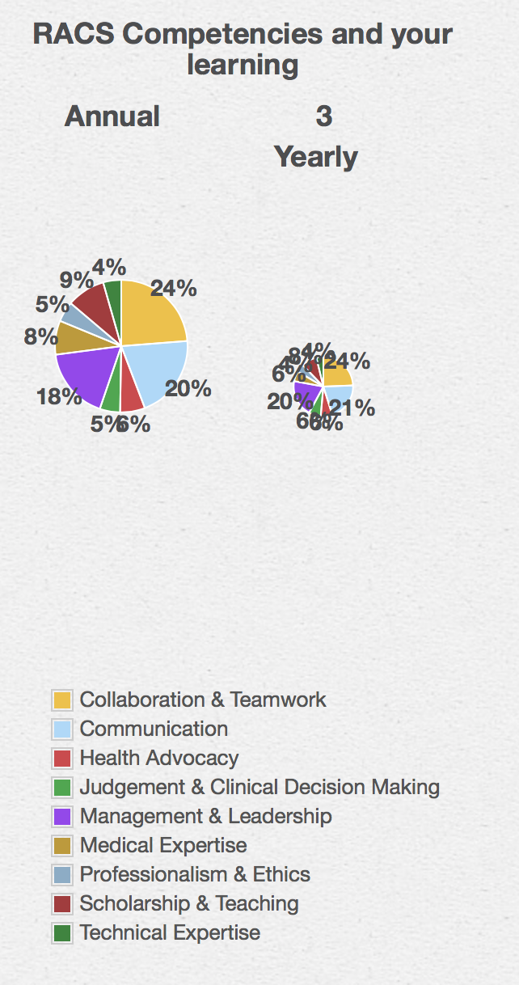
Notes:
Also on your Portfolio page you see the infometric with the breakdown of coverage of competencies covered by all 4 components of your CPD. Note that mine is lacking in technical expertise.

Slide 35
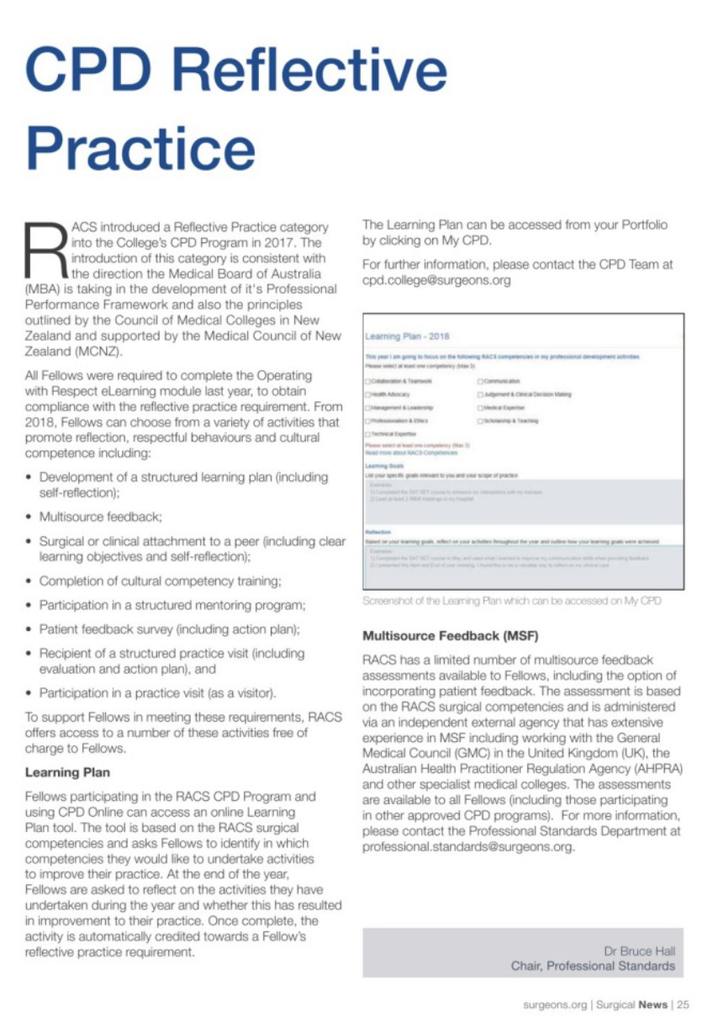
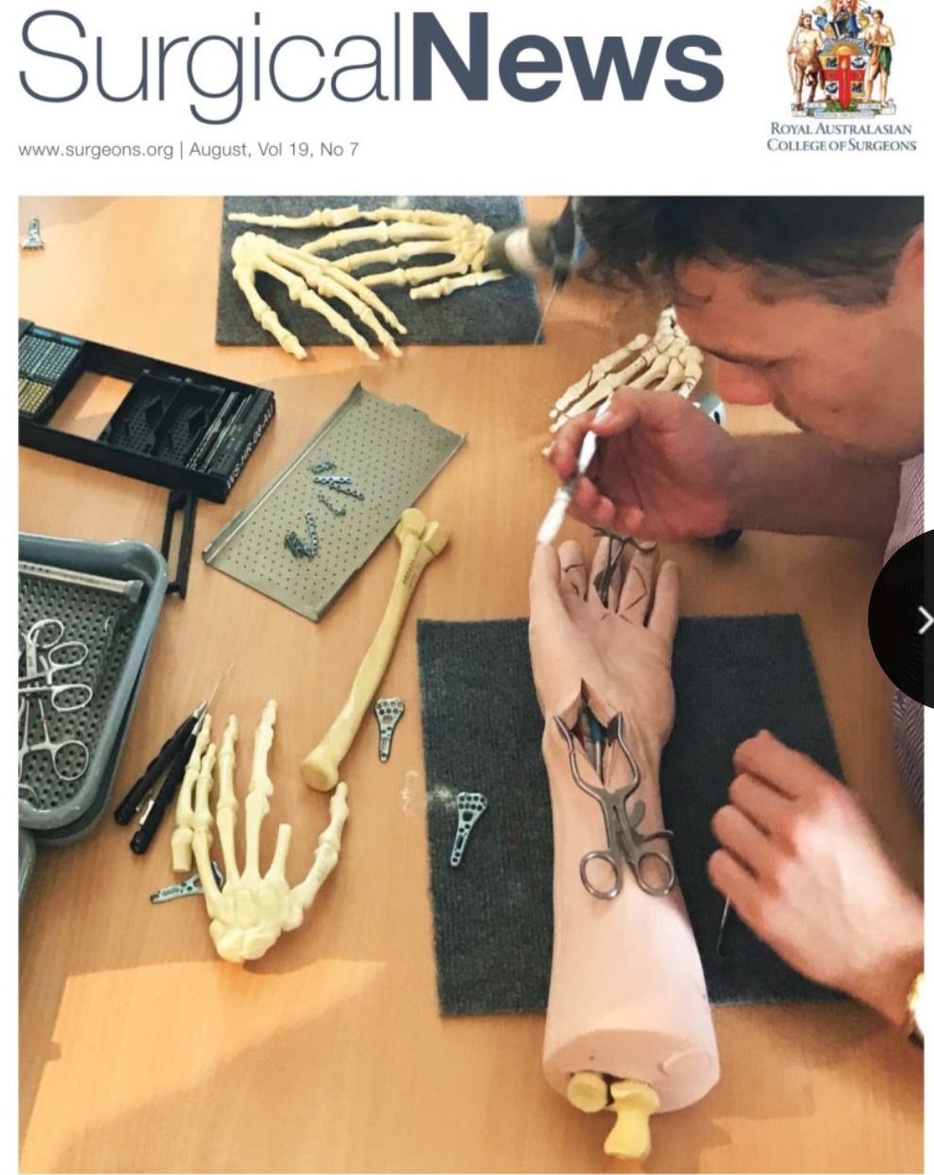
Notes:
In August Surgical News, Bruce Hall Chair of Professional Standards.

Slide 36
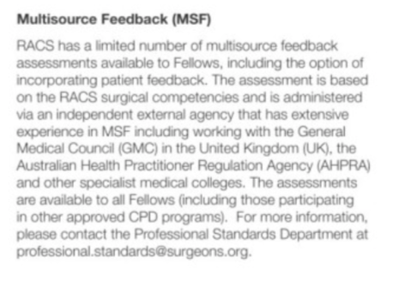
Notes:
Multisource feedback can be interesting and useful. There is limited availability of this. If you are interested in doing MSF, or have been recomended to do it you should contact CPD enquiries.

Slide 37
Notes:
You may wish to pursue other methods of achieving your Reflective Practice eg Patient Feedback survey, Practice Visit. However for many of our Fellows, I would recommend Learning Plan and Cultural Competency especially if you are looking at compliance by the end of this CPD year.

Slide 38
RACS CPD

