Slide 1
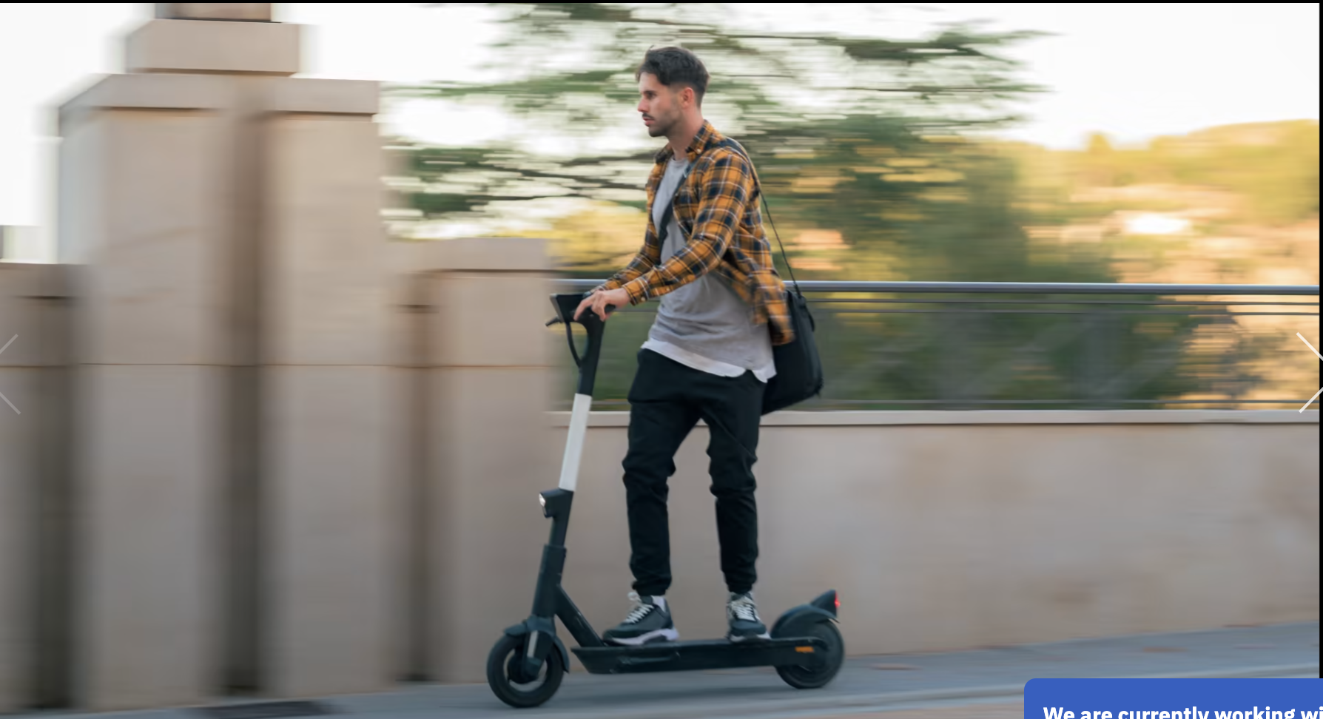
Clinician e-Scooter Advocacy
Where to Next?

Slide 2







Slide 3
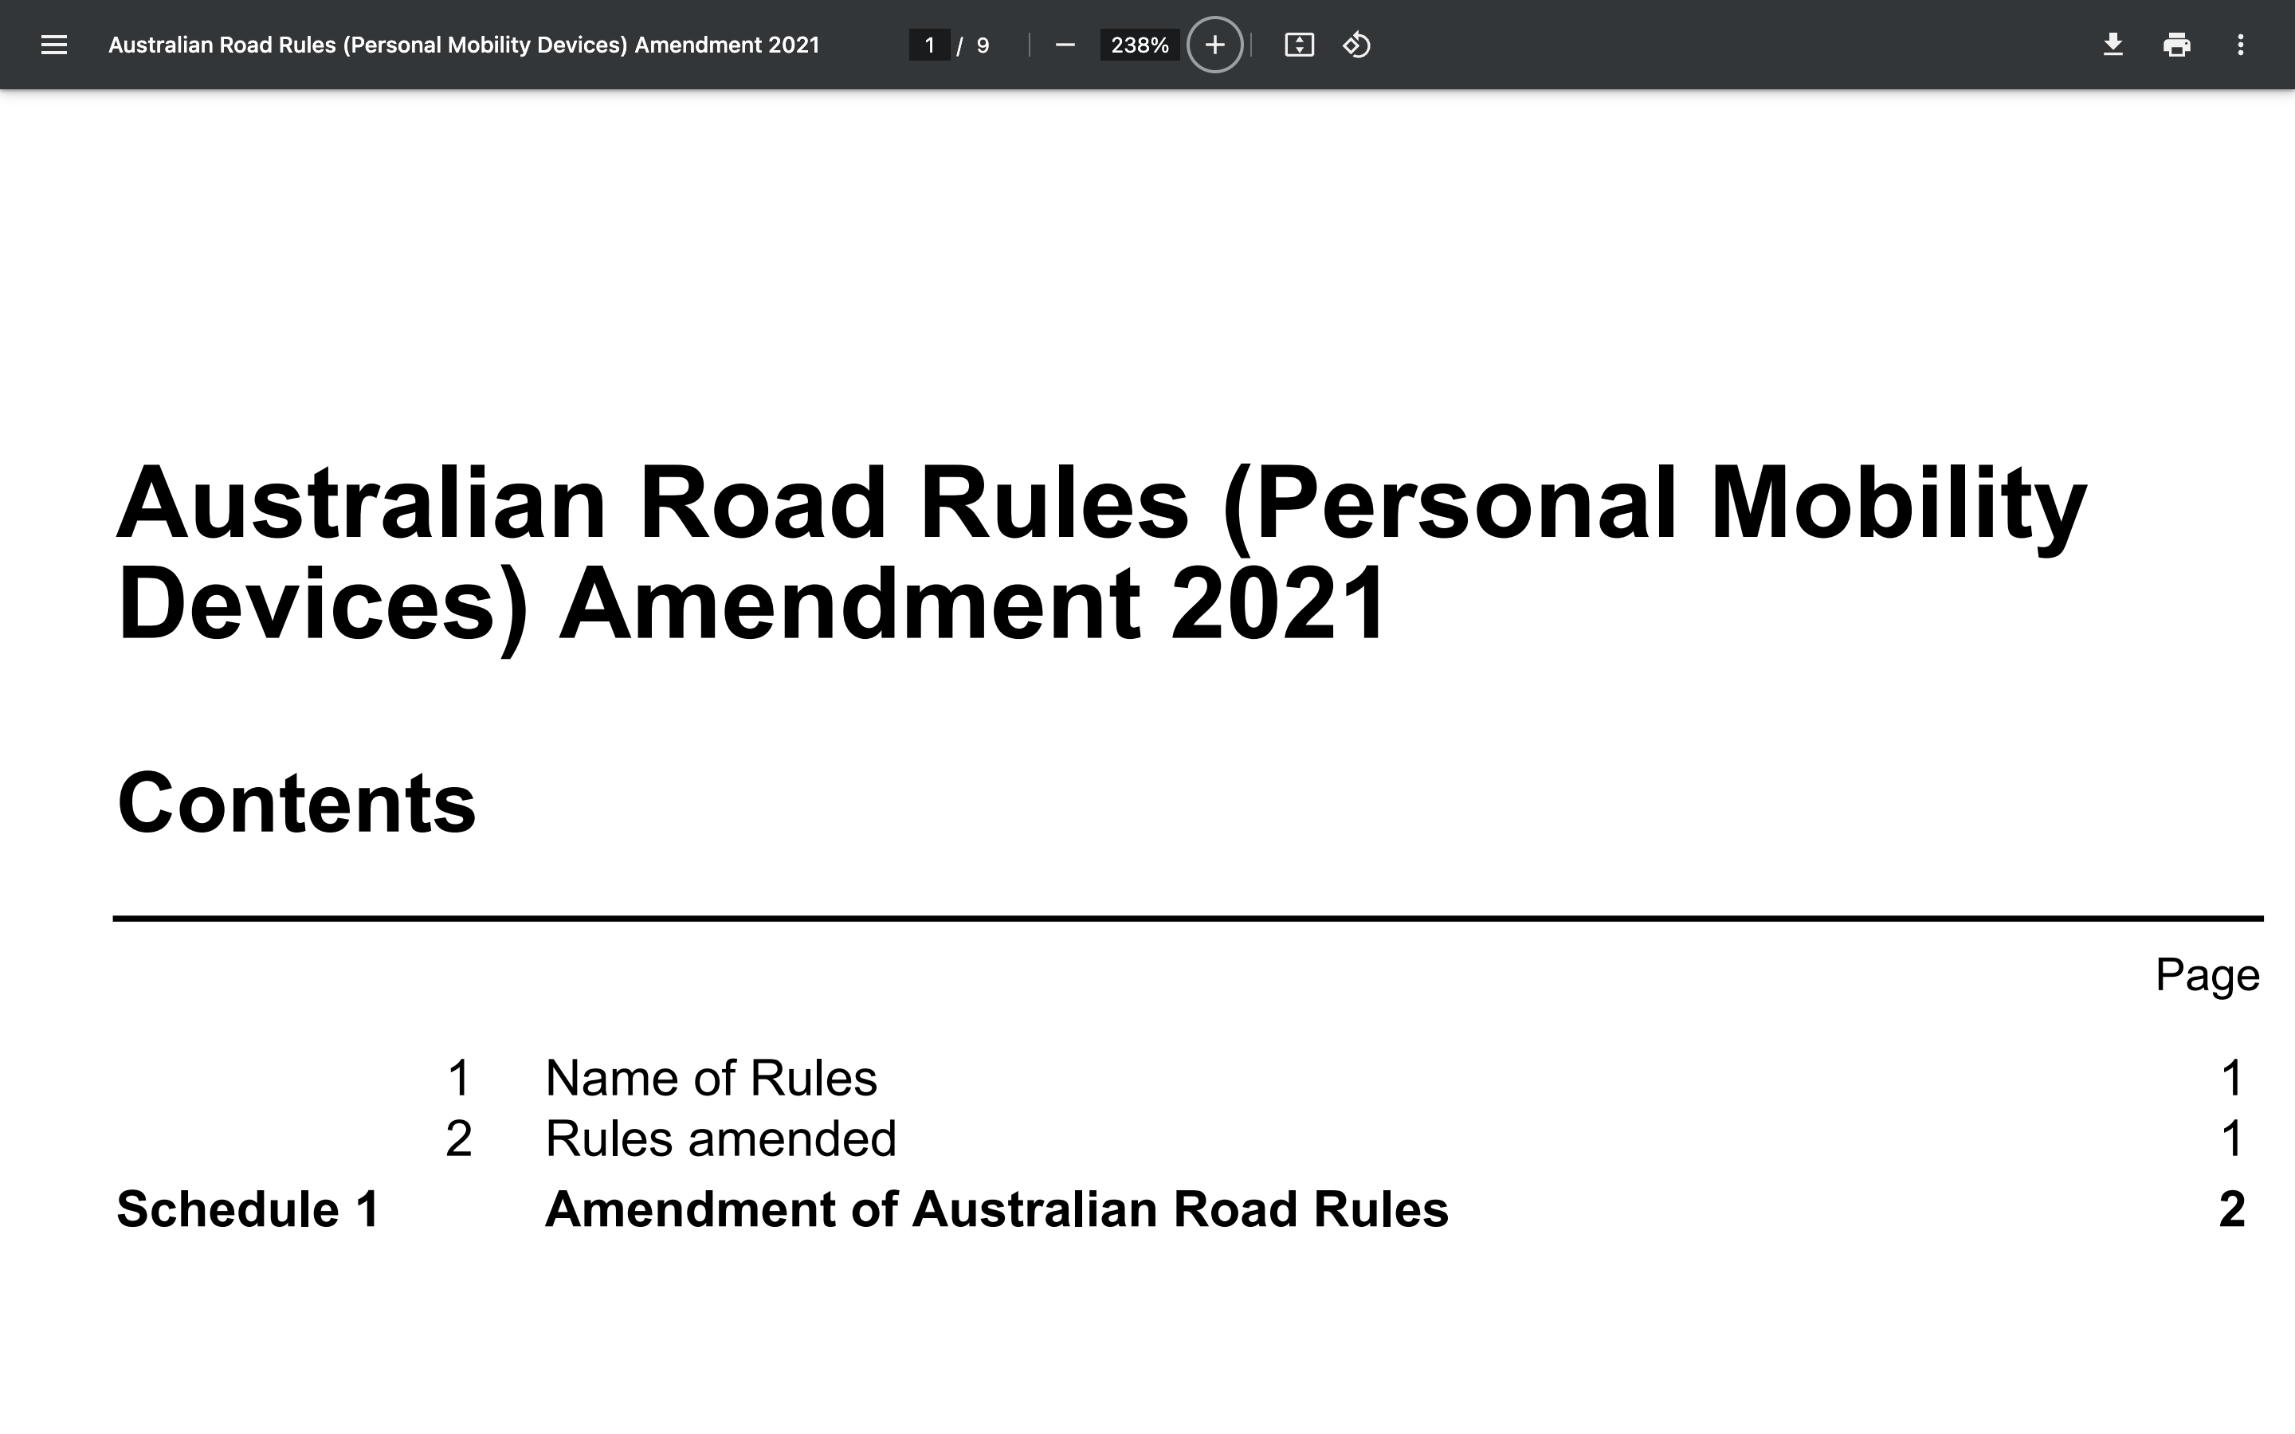
Device Classification
Maximum Speed
Minimum Age
Access to Infrastructure including Footpaths, Roads, Shared Paths
Helmets
Blood Alcohol Concentration and Drugs
Number of Riders
Mobile Phones

Slide 4


Slide 5
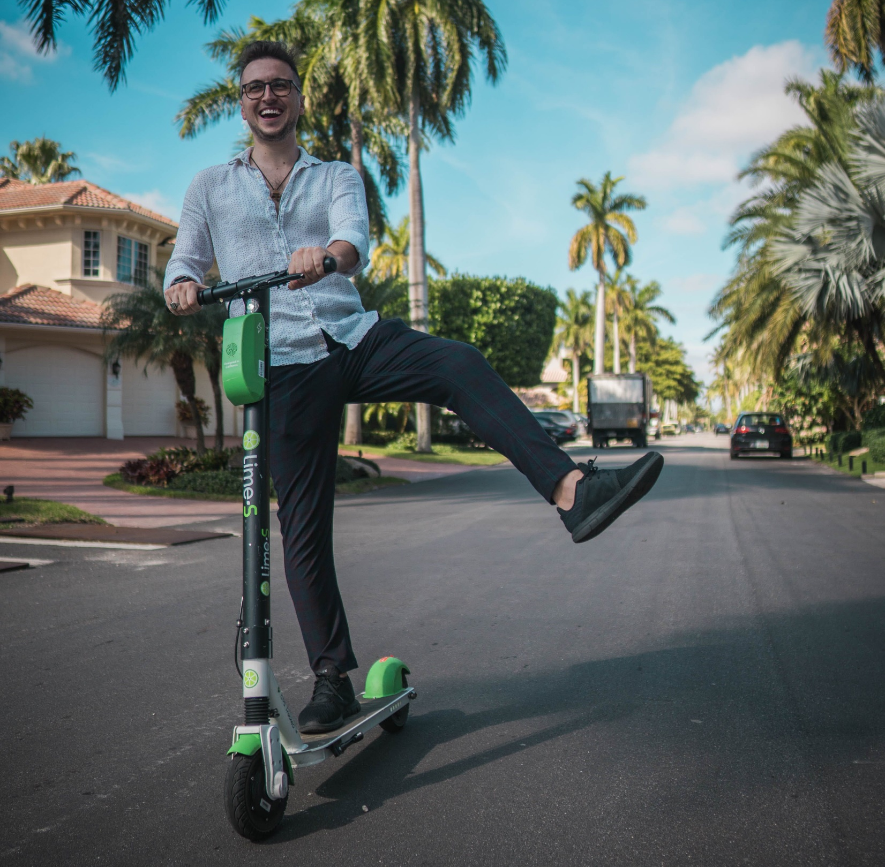
Injuries
Young Males
Speed
No Helmet
Intoxicated alcohol or drugs
Extremities, face
Warmer months
Weekends
Evenings
Delayed presentations
Falls > collisions

Slide 6
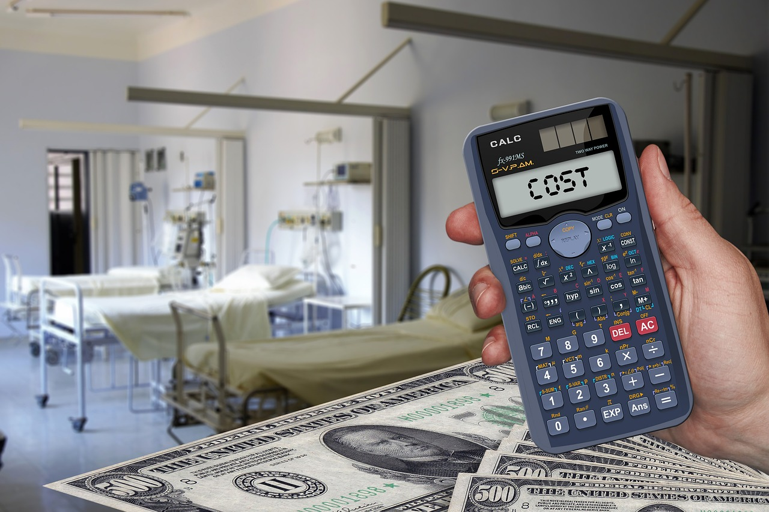

Slide 7



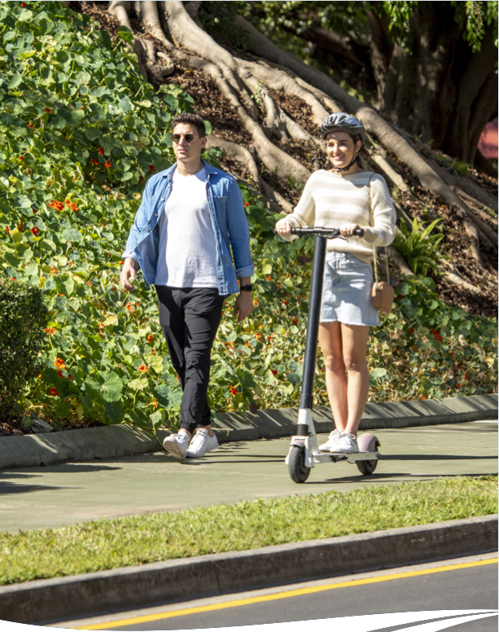

Slide 8

Network, Policy and Reform Branch
State E-scooter Reference Group and Advisory Committee
Advise the Minister
No Health representation

Slide 9
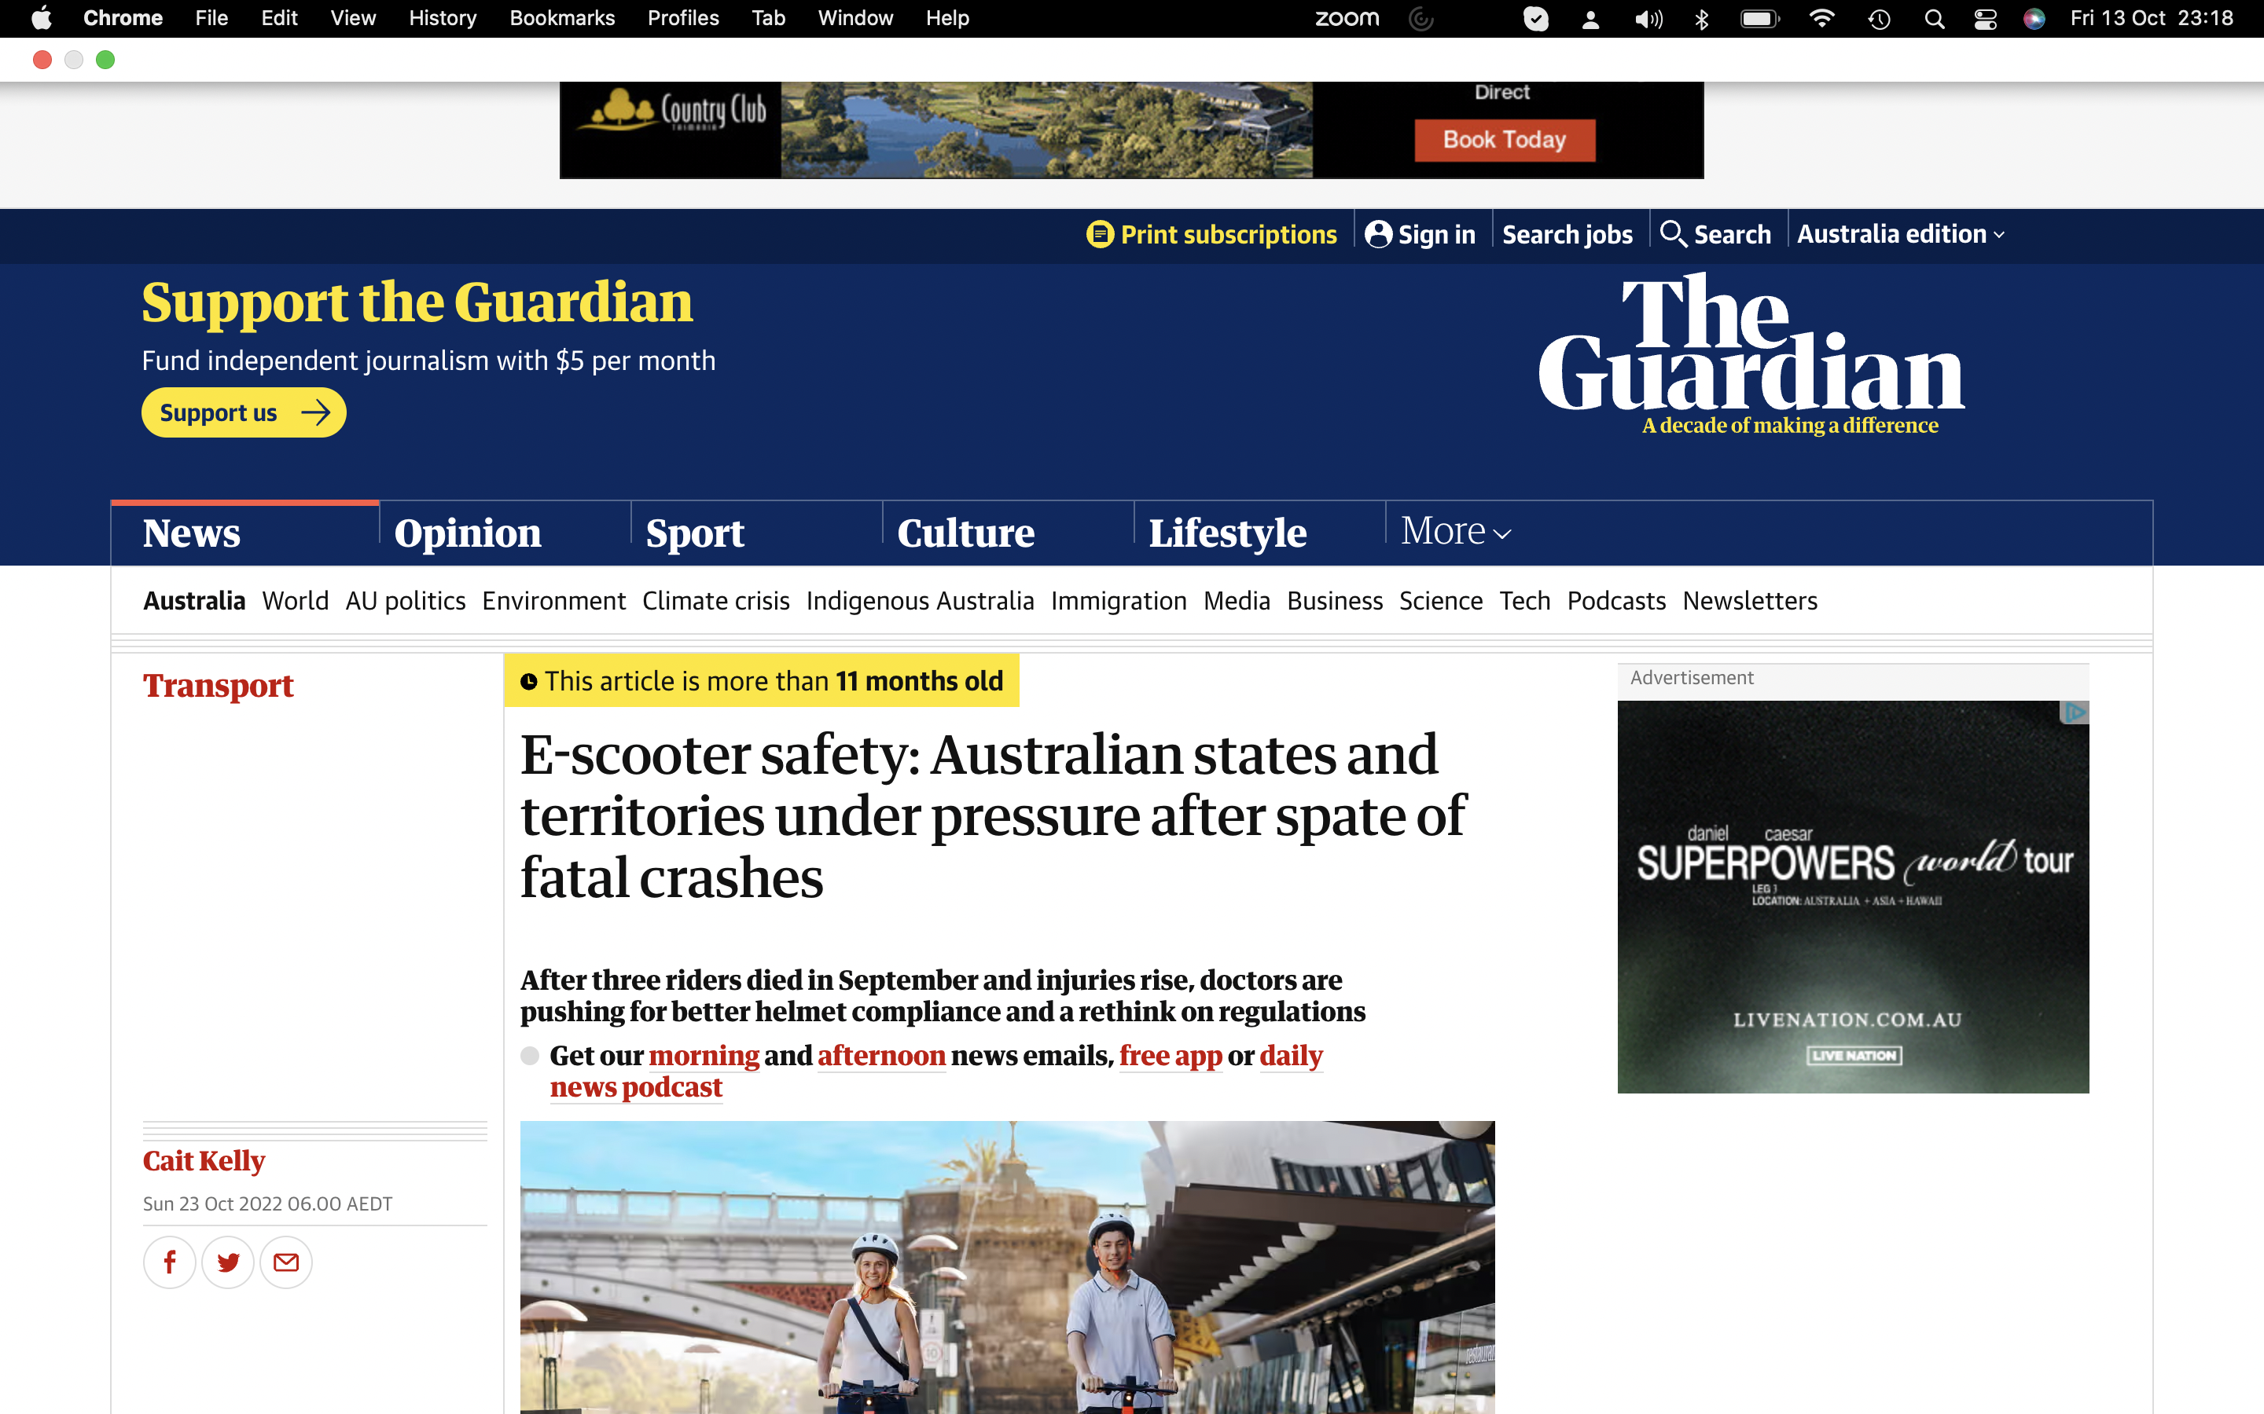



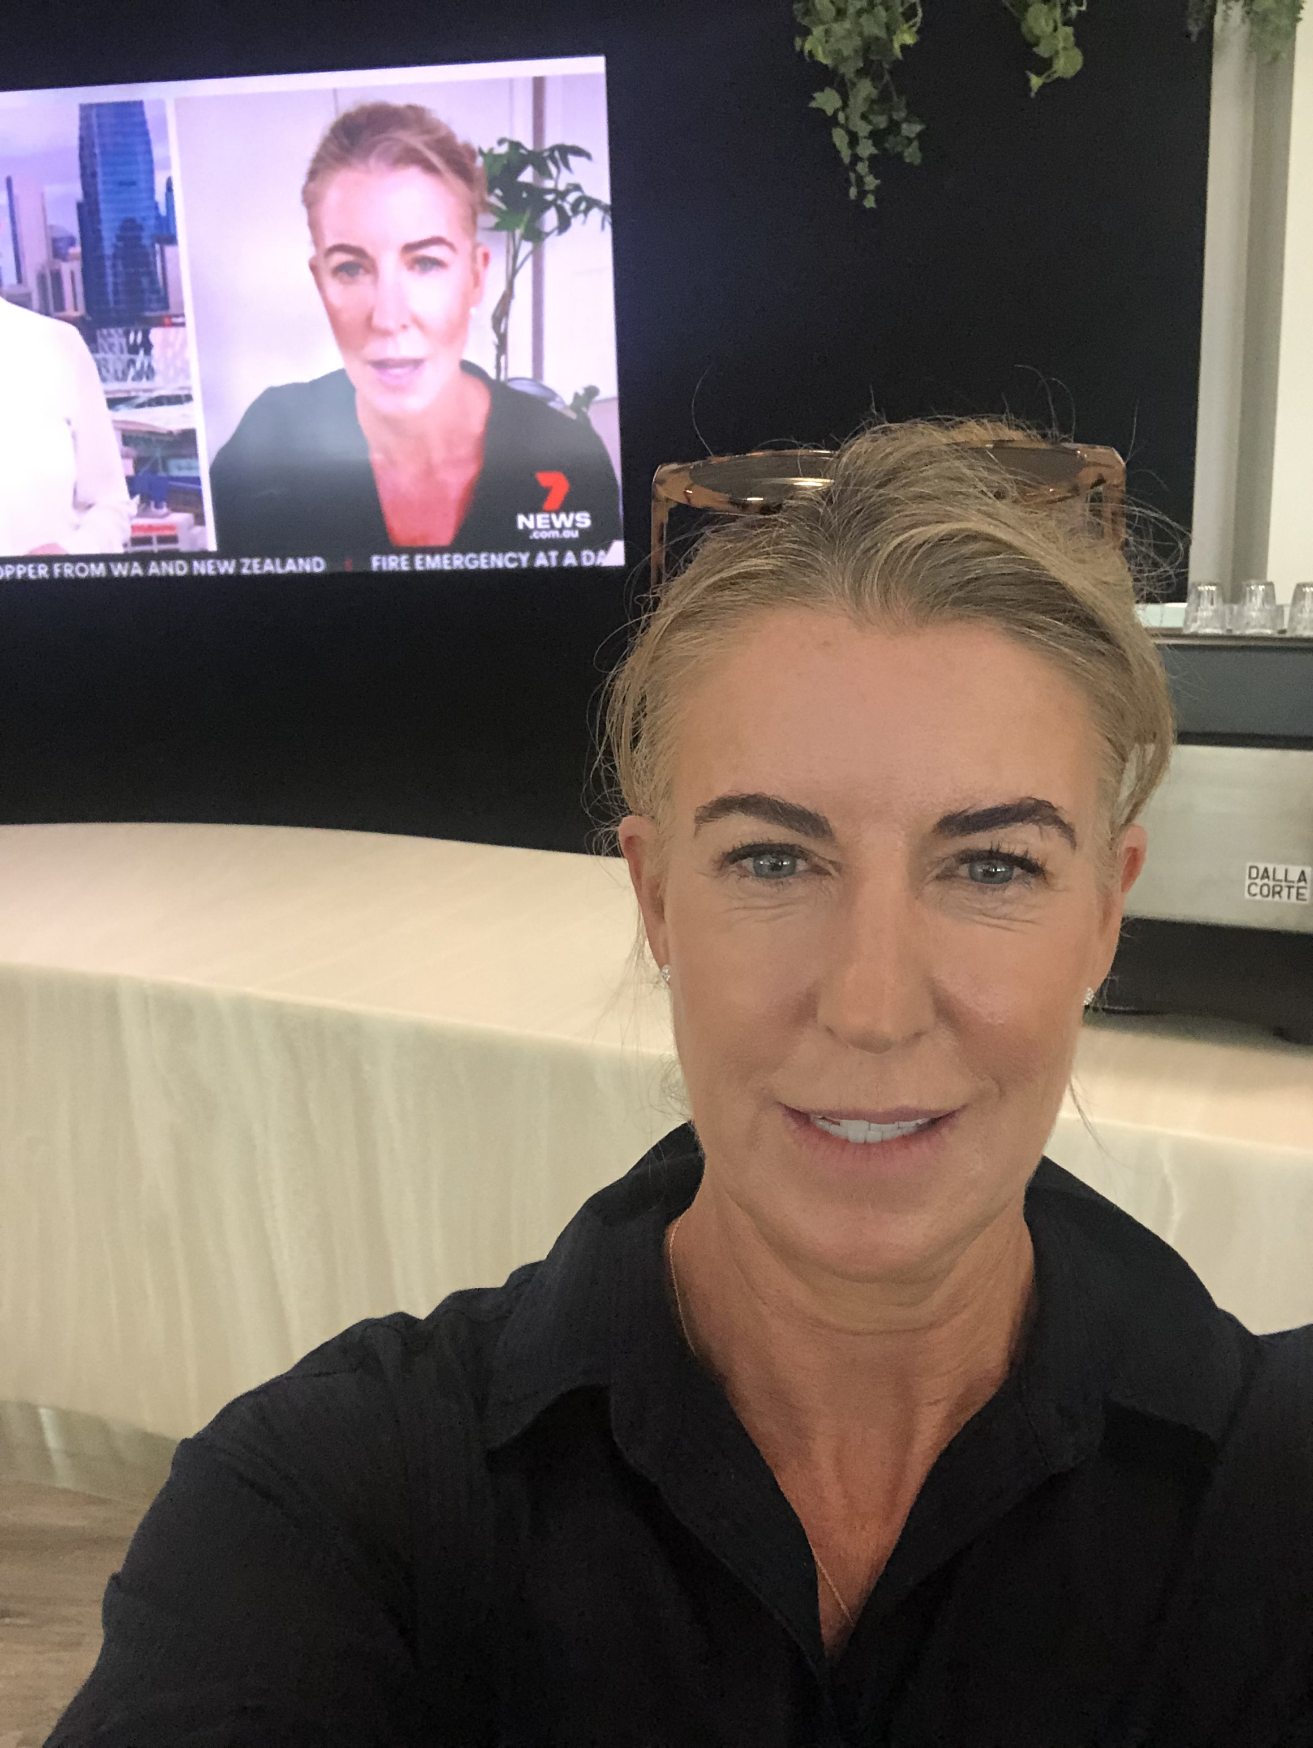

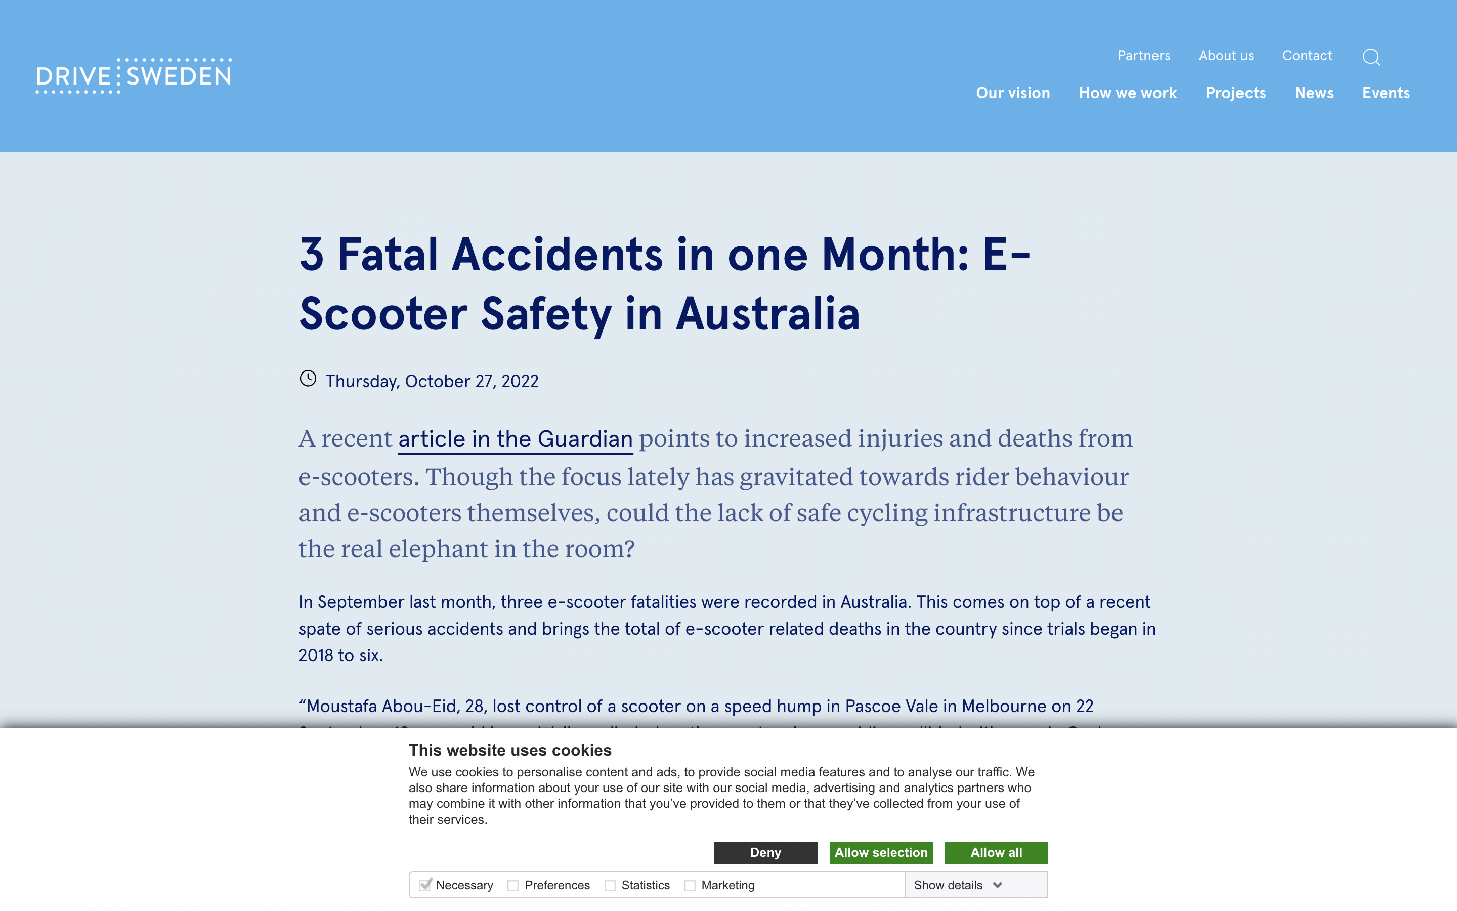
Police to crack down on drink riding as e-scooter deaths and injuries mount

Slide 10
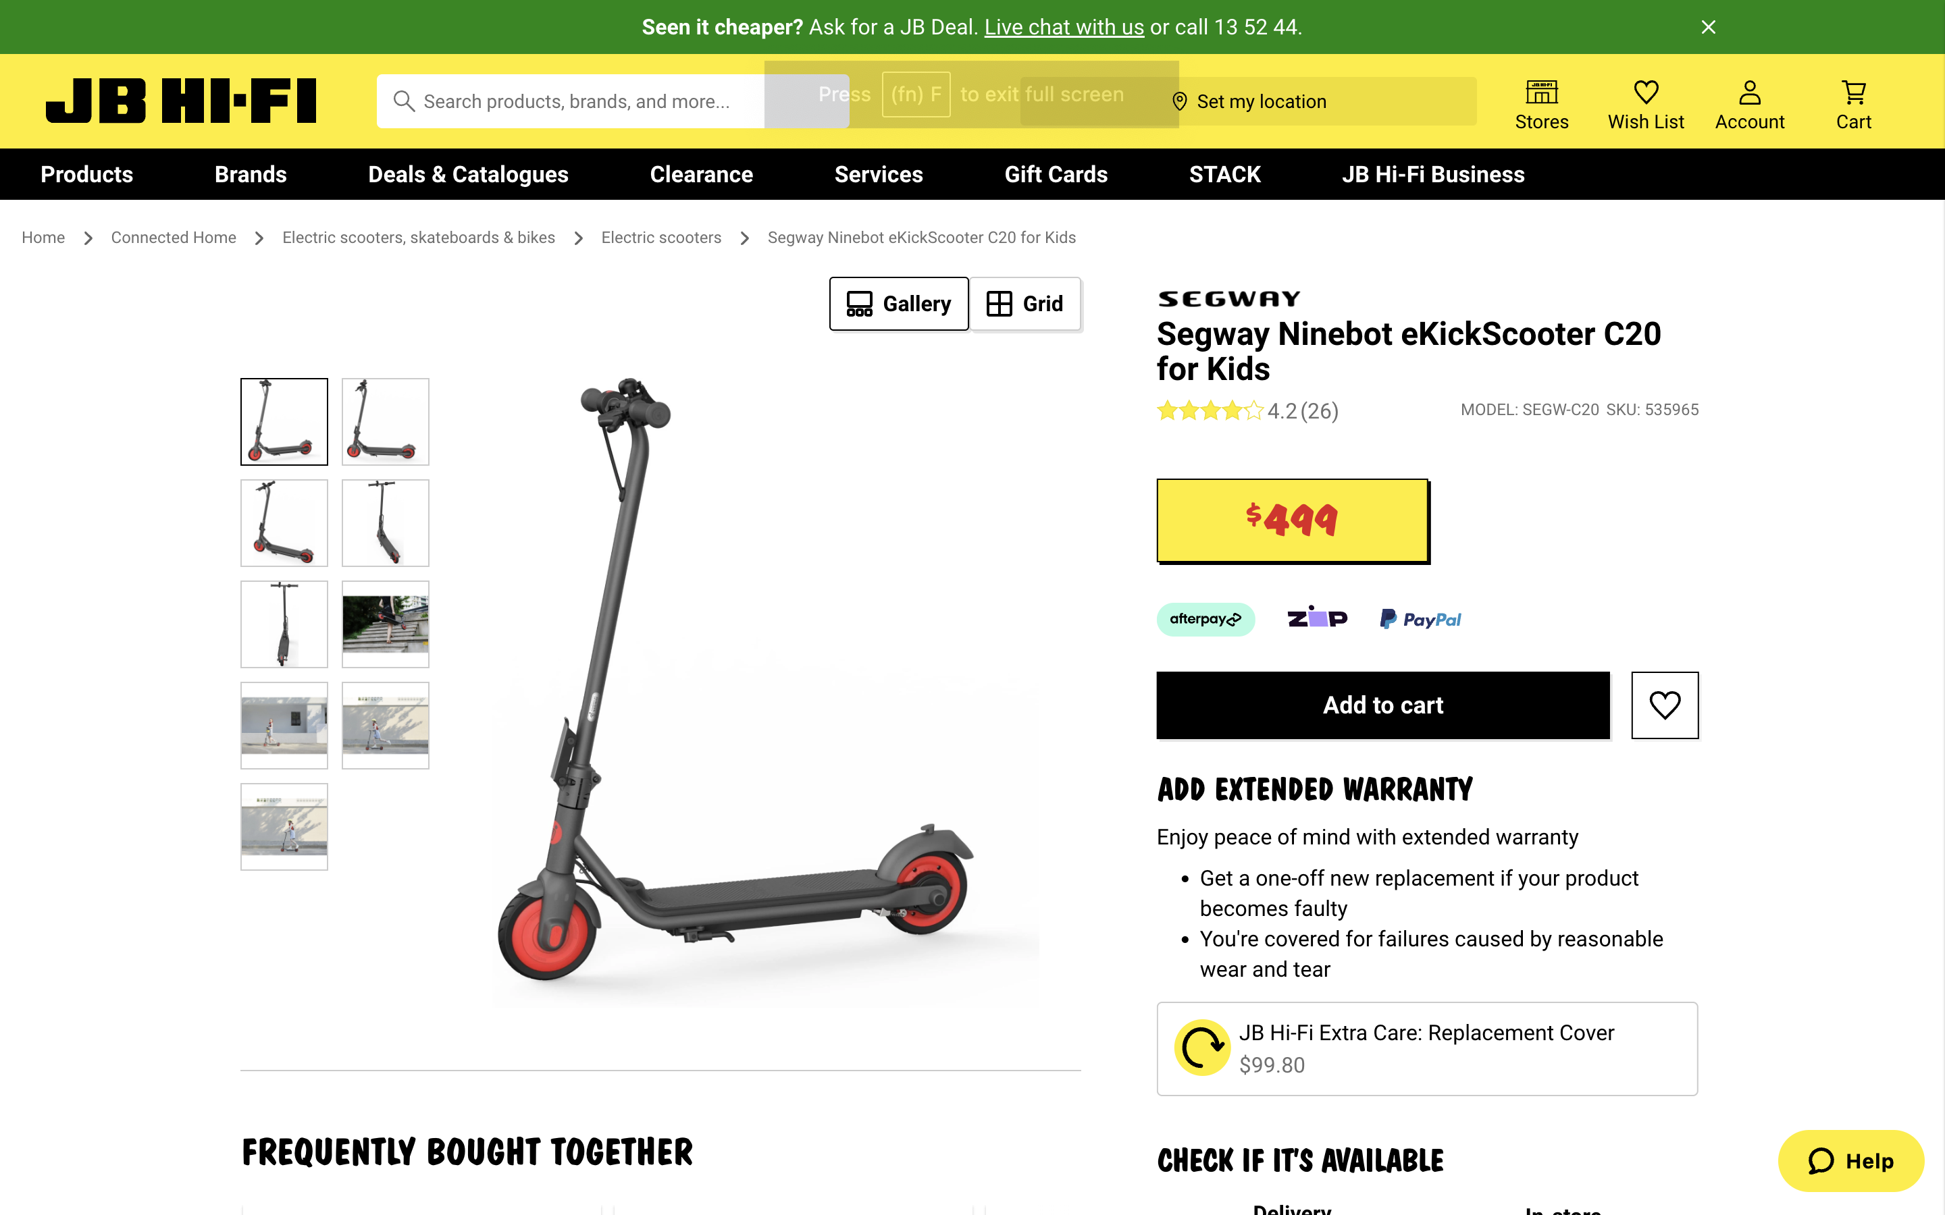

Trauma 2023 Conference
#TraumaANZ

Slide 11
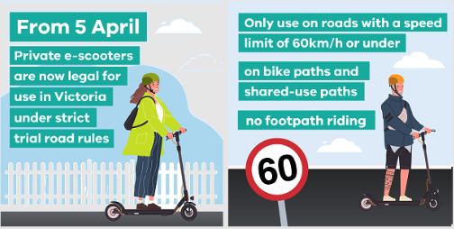

Slide 12

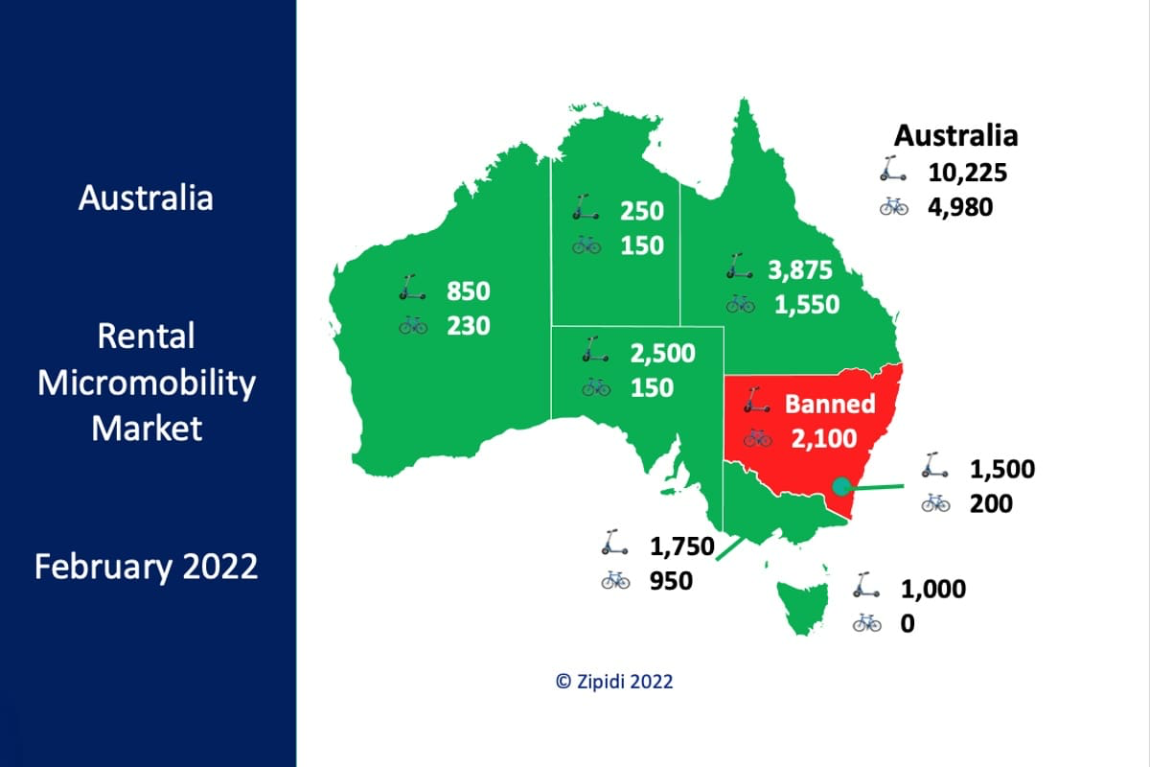

Slide 13

Priorities:
Funded Focused Data Collection
- Nationally Consistent
- Health Cost Analysis
- Health Perspective in E-scooter Governance
National Transport Commission

Slide 14
Priorities:
Public Education
- A Culture of Safety
- Helmets, Speed, Drug and Alcohol Intoxication, Riding Safely

Slide 15
Priorities:
Optimisation of Safe E-scooter and Protective Equipment Design
- Evidence based Import and Sales Restrictions
Federal Department of Transport and Infrastructure
ACCC

Slide 16
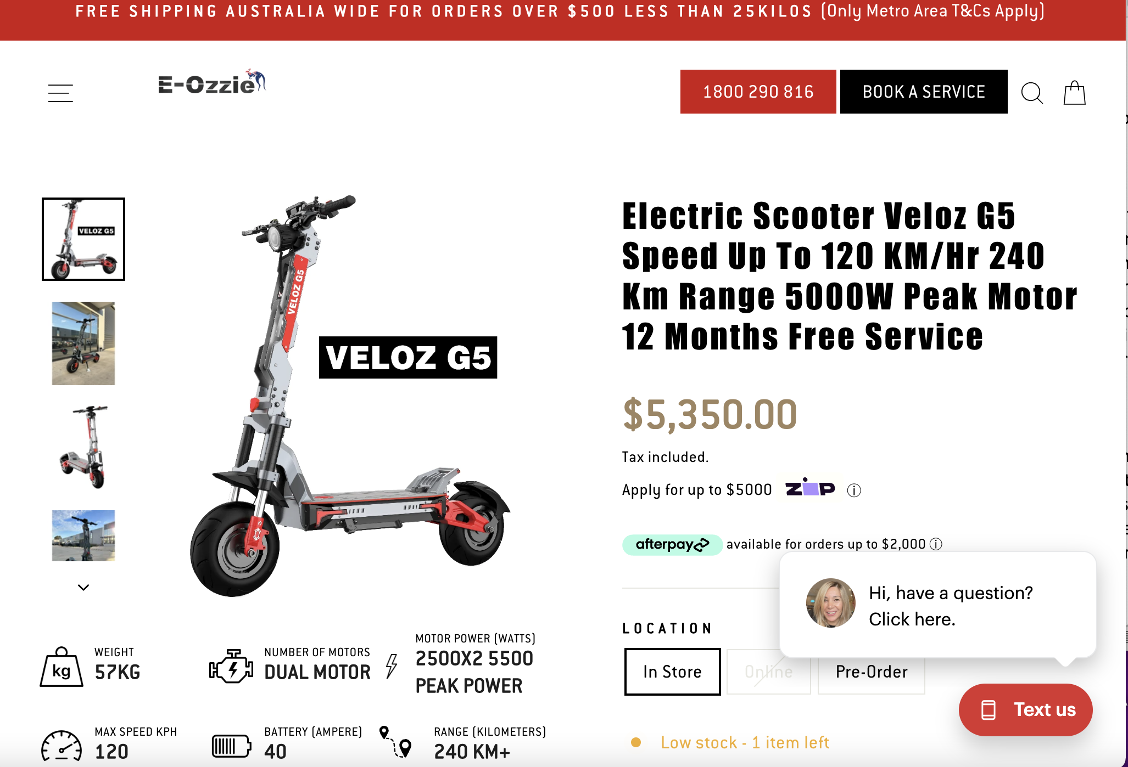




Slide 17
Priorities:
Optimisation of the Australian Road Rules
- National Consistency of Regulation and Classification
- Shared funding of Associated Costs
- Infrastructure and Injuries
- Consideration Registration and Rider Training
Road Safety Ministers Meeting

Slide 18

The Safe System Approach:
- Safe Roads
- Safe Vehicles
- Safe Road Use
- Safer Speeds
- Post Crash Response =
Emergency Medical and Rescue Response,
Trauma Care and Injury Rehabilitation

Slide 19
Priorities:
Connect With Each Other
- Support Expert Perspectives
State Government
Local Councils
State and Federal MPs
Coordinated, State and National Strategic Research

Slide 20

Thank you

