Slide 1



Infections in Surgical Patients:
Intensive Care Unit
A/Prof Peter Kruger
Deputy Director
Intensive Care Unit
Princess Alexandra Hospital
QASM November 2018

Slide 2
Declaration:
None Relevant to this presentation
Research and Educational support from Astra Zeneca
Educational support and consultancy Smiths Medical

Slide 3
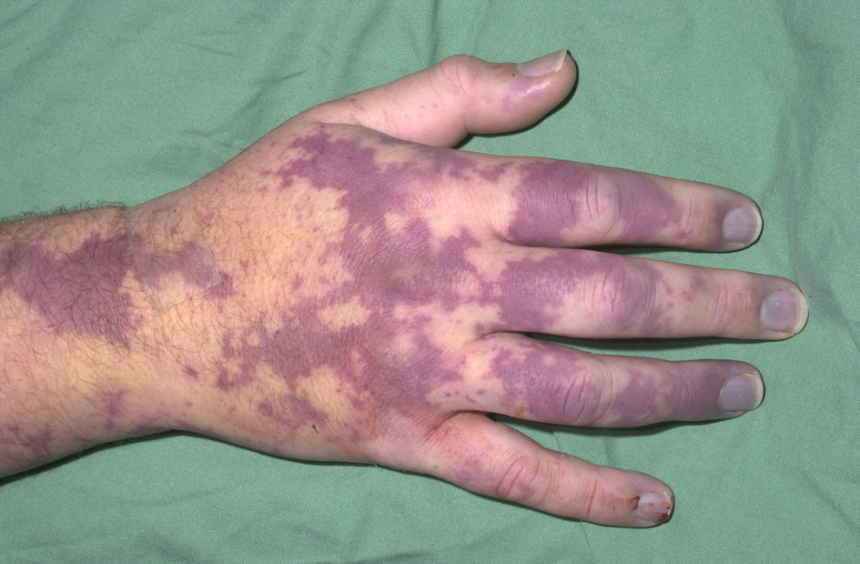
Community Acquired infection
Hospital Acquired infection

Slide 4
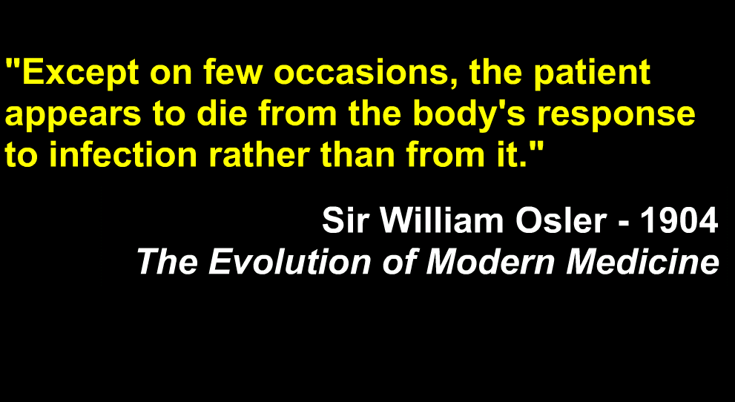

Notes:
4

Slide 5
SIRS: 2 or more of the following
Temperature
Heart Rate
Respiratory Rate
or PaCO₂
White Cell Count
> 38º or < 36º
> 90 beats / min
> 20 / min
< 32 mmHg
> 12,000 / mm3
< 4,0000 / mm3
> 10 % bands

Slide 6
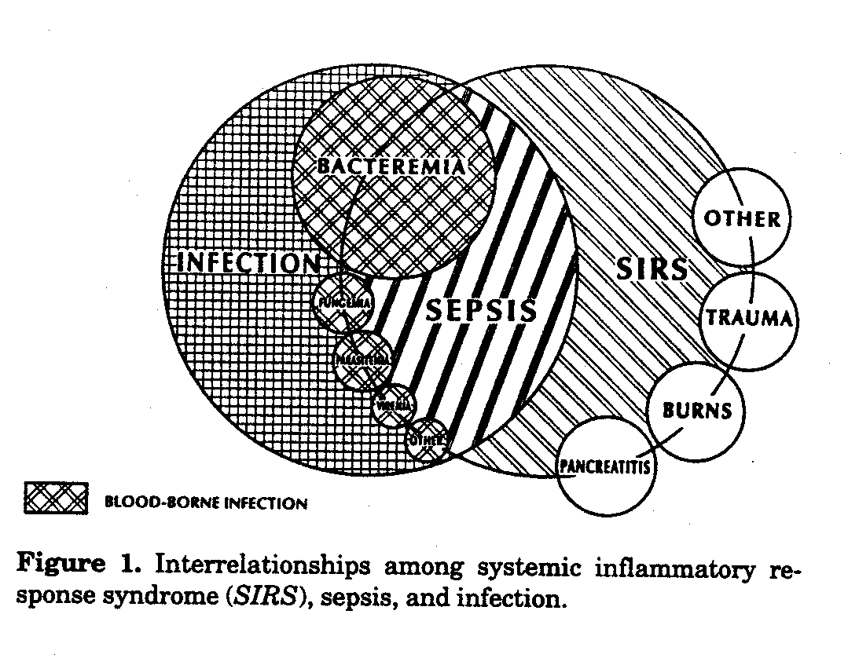
Not all infection:
Chest 20(6): 864 , 1992

Slide 7
Life threatening organ dysfunction caused by a dysregulated host response to infection
For clinical use = ↑ of SOFA score of 2 points or more
This is associated with > 10% hospital mortality
Septic Shock
  Low BP = needs vasopressors for mean > 65mmhg
  Lactate > 2 mmol/L in the absence of hypovolaemia
  Hospital mortality > 40 %

Slide 8
Not sure what happening:
Could it be Sepsis ?

Slide 9


Slide 10
Treating sepsis:
Early Recognition
Early appropriate antibiotics (dose matters)
Source control
Haemodynamic stabilisation
  fluids / vasopressors
Organ Support – I hope it helps ?
Immune modulation
  Science vs Magic ?

Slide 11

Things that don’t work
Inhaled
Nitric Oxide
Supra normal
oxygen
High dose
Steroids
Protein C
Tight
Glucose
control
Stains
Albumin
BLOOD
TFPI
TNF
M Ab
L-NMMA

Slide 12
We are doing OK ?
No need to worry – looks like we are heading to the right place

Slide 13
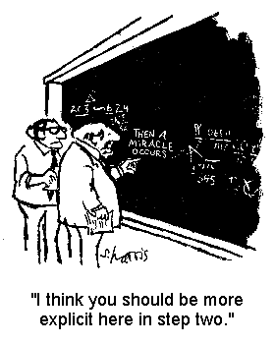
What is making the difference ?

Slide 14
Why would that matter ?
Keep doing things that help
Stop doing things that don’t
Start doing things that might ADD VALUE
Look at what’s COST effective
Insight into which things help some but not all patients

Slide 15

Apart from the definition ?
Why is it worse in some people ?
What Antibiotics ?
  Drug / Dose / Regimen / Duration
What Fluids ?
  Type / Volume / Timing
What Vasopressor
  Agent / Target BP

Slide 16
Sepsis: What’s new in the ICU ?
High Flow Nasal Oxygen
Steroid use
Fluids and Vasopressors
Frailty
  Perhaps get out of ICU
  Less sure you get out of hospital
MAbs – new indications and complications

Slide 17
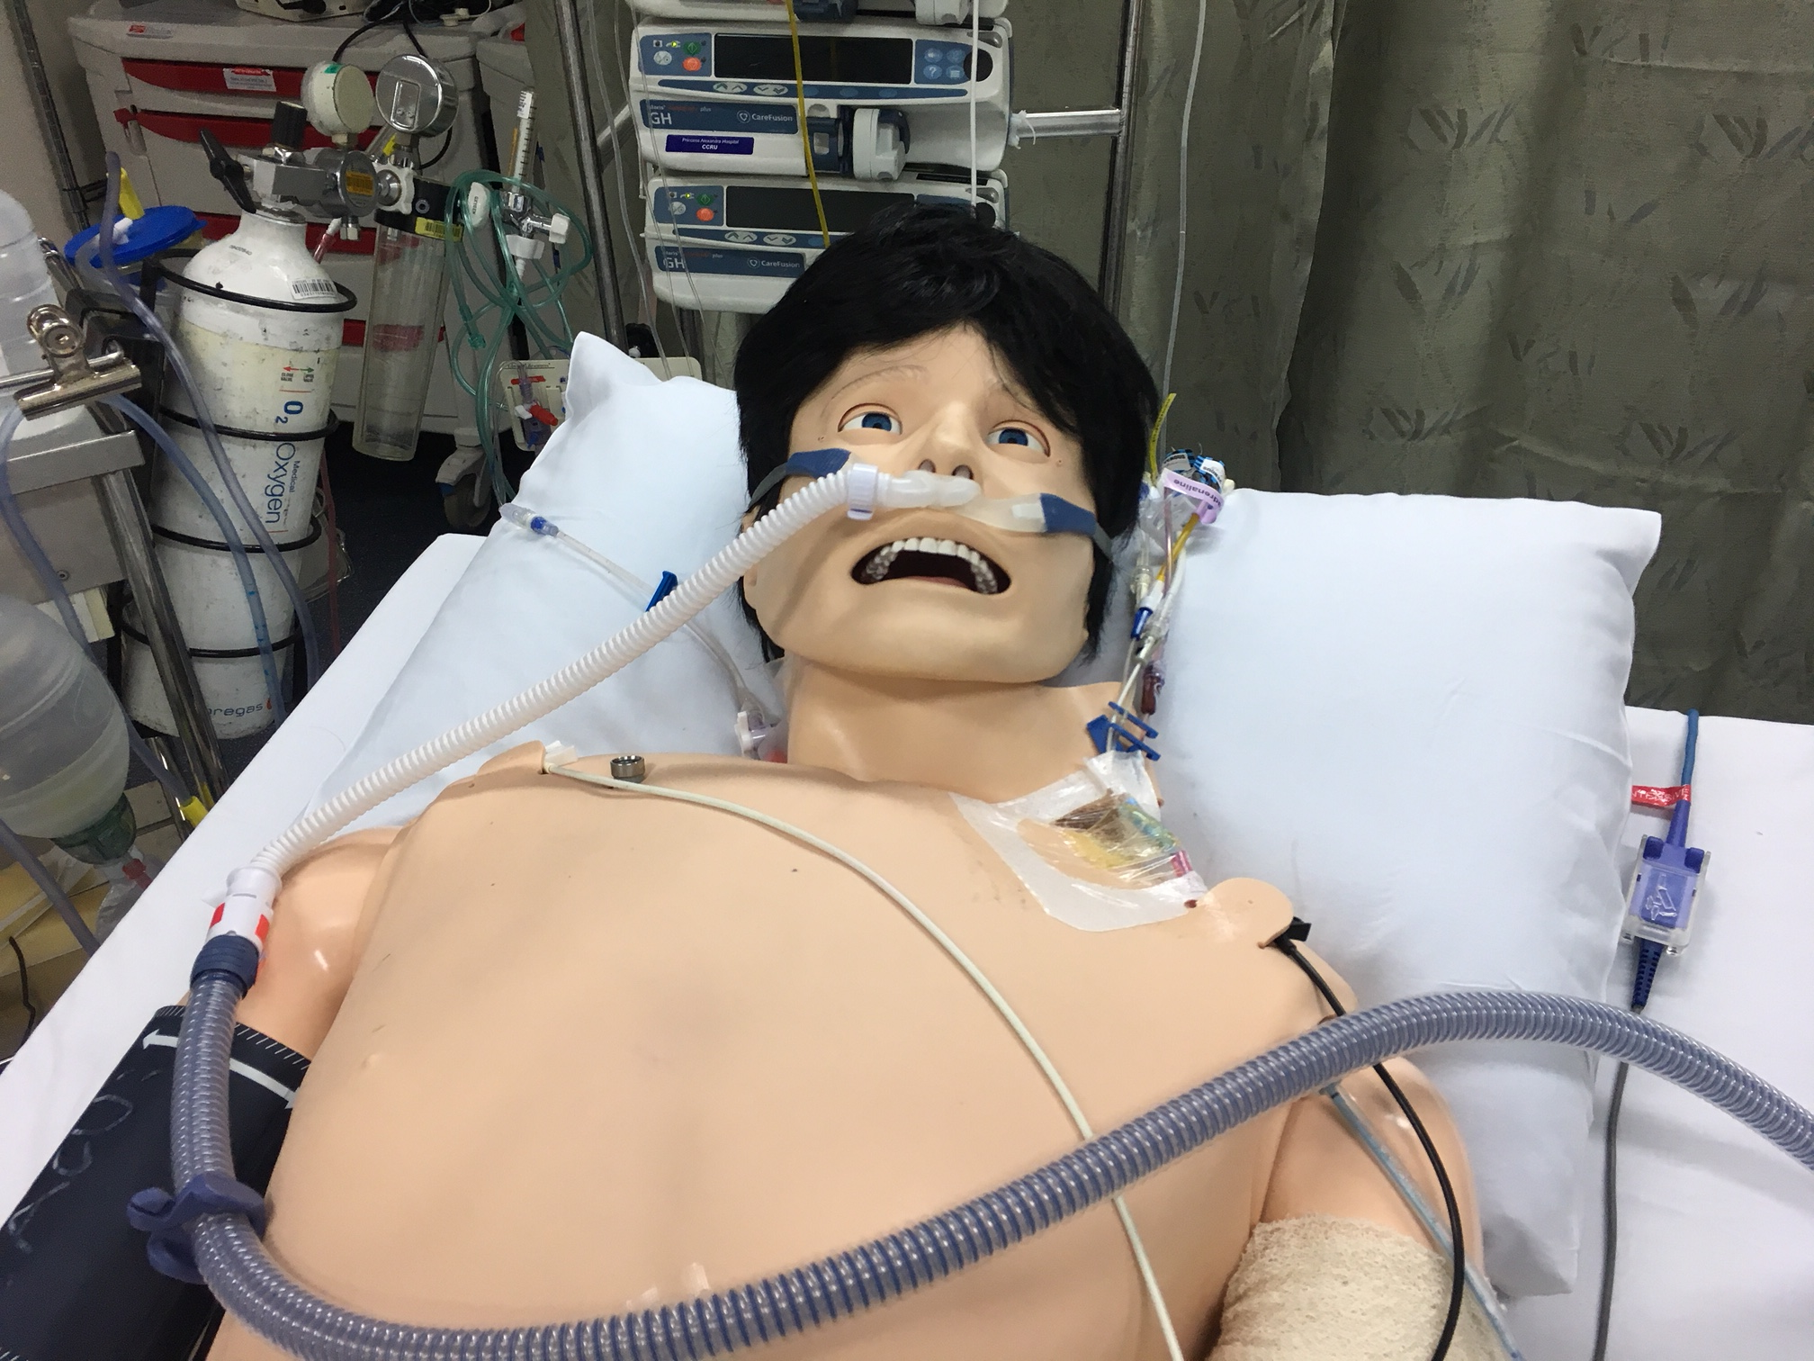
High Flow Nasal Oxygen:
Might saves NIV or intubation but that doesn’t mean your not sick !
May actually provide significant support
Look at Flow rate not just Fi02
Complex Physiology
Multiple Effects

Slide 18
STEROIDS:
You might see Hydrocortisone used more often
Particularly in Septic shock
Often at a dose of 50 mg QID
  Faster shock resolution
  Perhaps less time on Mechanical ventilation
  Perhaps improved survival

Slide 19
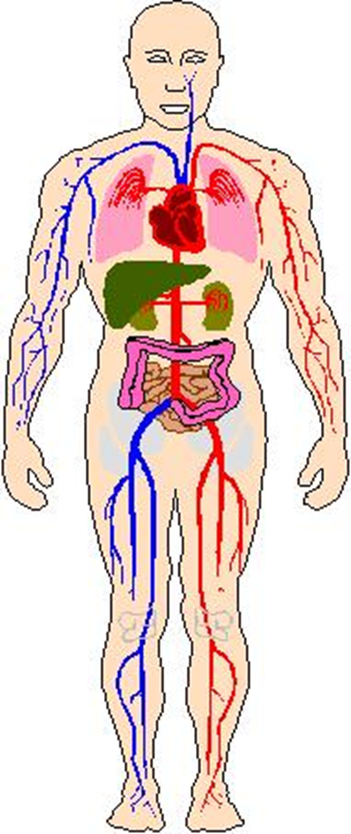
Sepsis Resuscitation
Early Antibiotics
Fluids
  Review Response
Vasopressors
Blood Pressure Goals

Slide 20
Time to Antibiotics is Key

Slide 21
Adequacy of initial antibiotic therapy

Slide 23
“Bundles” of Care

Slide 25

Several Trials now suggest care about fluid balance could improve patient outcome
Surgical post op literature
Cardiac surgical literature
ARDS
Acute Kidney Injury
U

Slide 26
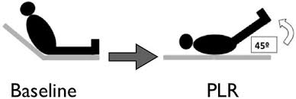
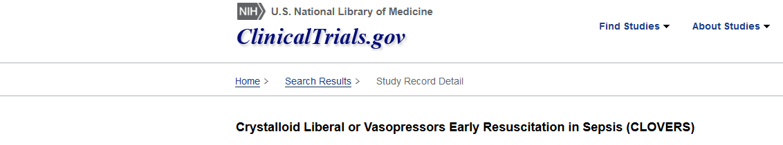

Slide 27

Drugs to Increase Blood Pressure:

Slide 30

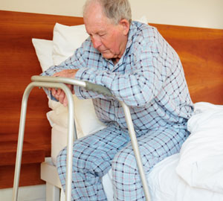
Frailty
How do we account for this ?

Slide 31

Education and Research are Vital

Slide 32

Are large pragmatic trials the answer?
Would Penicillin survive the rigours of a multicentre RCT as a treatment for sepsis
  Not everyone has an infection
  In those that do – they are not all Gram positive organisms
  Some people might be harmed eg. allergy
  What about the Dose ?

Slide 33

A risk with pragmatic RCT’s
  Diluting real effect with large trials of a not widely applied therapy !
RCT does demonstrate causal inference

Slide 34


New Research Tools ?
“Digital Exhaust”

Slide 36
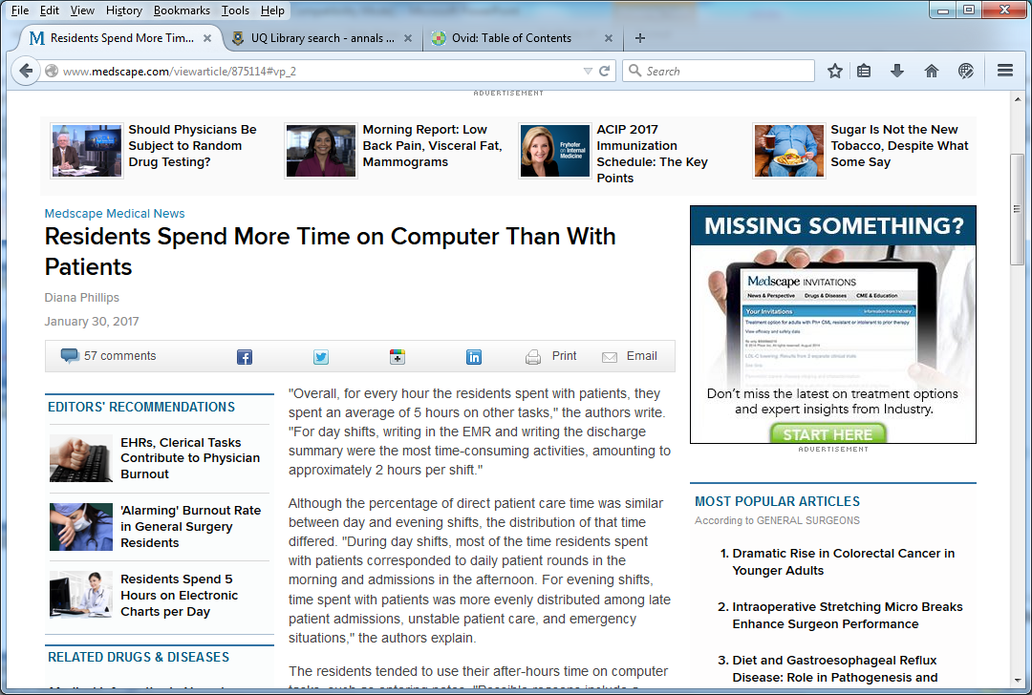
Wenger Et al , Annals of Int Med 2017

Slide 37
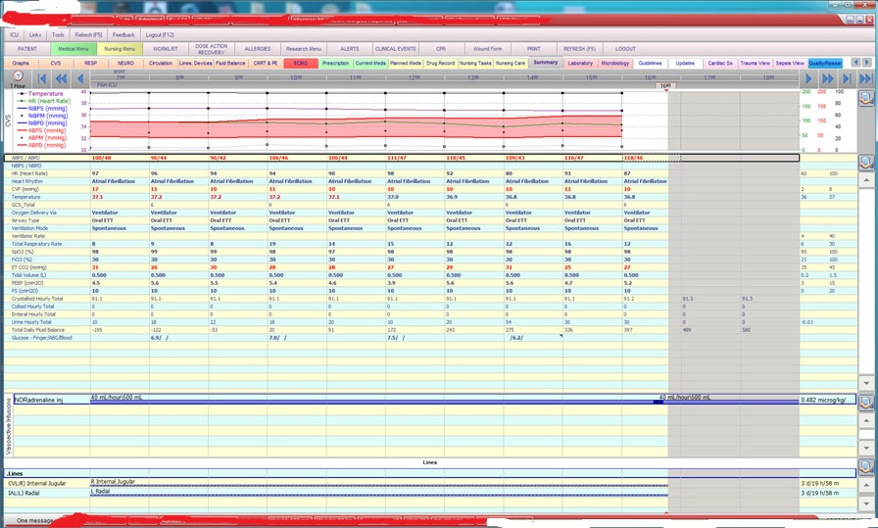
Could we make this do work for GOOD rather than EVIL ?

Slide 38
Learning not just Monitoring:
Dataset
  Large
  Well structured = Major Value
  Accurate
Confidence the data is True and Complete
Data Quality a huge issue
Use data to generate knowledge
Less Data but more accurate maybe better
The continually learning healthcare system

Slide 39
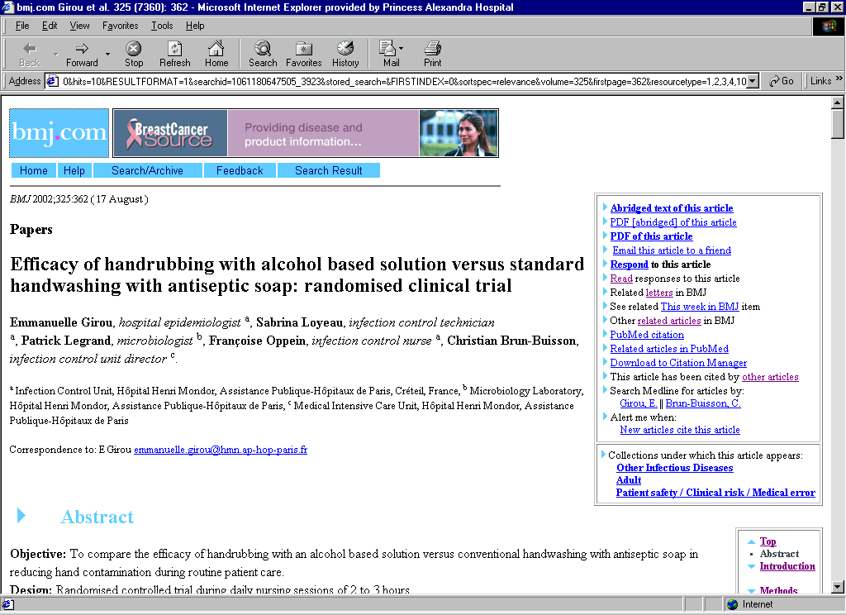
Don’t forget to wash your hands !

Slide 40


Thank You
www.intensivecarefoundation.org.au

