Slide 1
QASM Seminar
The Townsville Hospital
October 2019

Slide 2
WELCOME:

Slide 3

Traditional Owners of Country Acknowledgement
We would like to show our respect and acknowledge that we are meeting on the traditional lands of the Bindal and Wulgurukaba people. I would also like to pay my respect to their Elders, past and present.
Notes:
Please hide if in New Zealand – DO NOT delete slide
It is a RACS policy that at the commencement of each course there is a formal acknowledgement to country. Please ensure that you check the slides and have the CORRECT traditional owners inserted.

Slide 4
The QASM Team
Jenny Allen QASM Manager***
Sonya Faint Senior Project Officer
Candice Postin Project Officer
Therese Rey Conde Senior Research Officer***
Kyrsty Webb Administration Officer

Slide 5
No conflict of Interest
John North Clinical Director

Slide 6
Distance, Delay and the Deteriorating Patient:

Slide 7
Have we made a difference?
I believe we have ….
…….and a significant change
Let’s tell a recent story………………………..

Slide 8
Normanton, North Queensland
Normanton Hospital.
PO Box 33. Normanton. Qld 4890
Phone. +61 7 4745 2100 Fax. +61 7 4745 1244 Office hours. 0830 - 1700.
Distance to main referring hospital -
Mount Isa Base Hospital …….. 500km.

Slide 9
History :
Male – early 50’s
Steel beam falls on Right Leg
Crush injury to thigh and calf
Abrasions above and below the knee
Paraesthesia foot and toes
Painful to move ankle joint and knee joint

Slide 10
Plain Xrays :
No obvious fractures in lower limb

Slide 11
What do I do next ?
Submit to HHS rules
Call Mt Isa …………… for advice
Plan transfer to Mt Isa

Slide 12
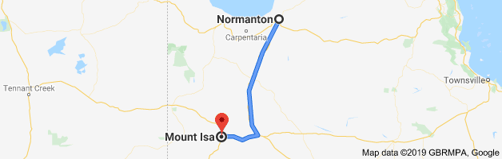
Normanton to Mt Isa :
501 kms by road
?

Slide 13
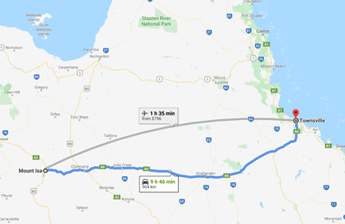
Mt Isa to Townsville :

Slide 14
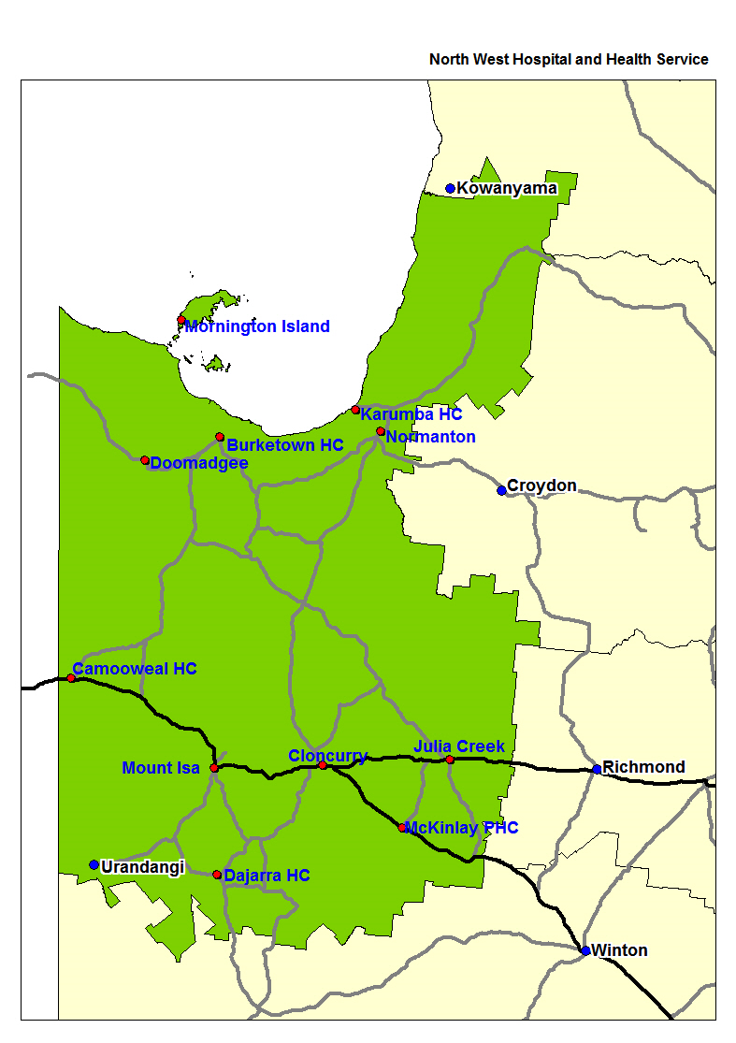
North West HSS Transfers

Slide 15
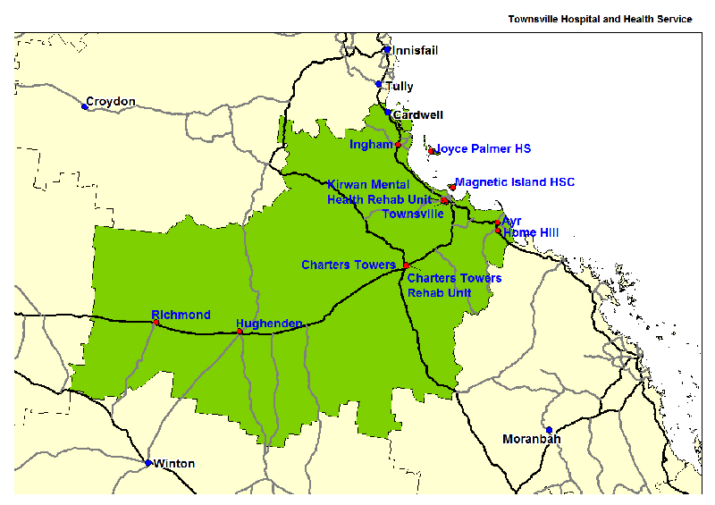
Townsville HSS

Slide 16
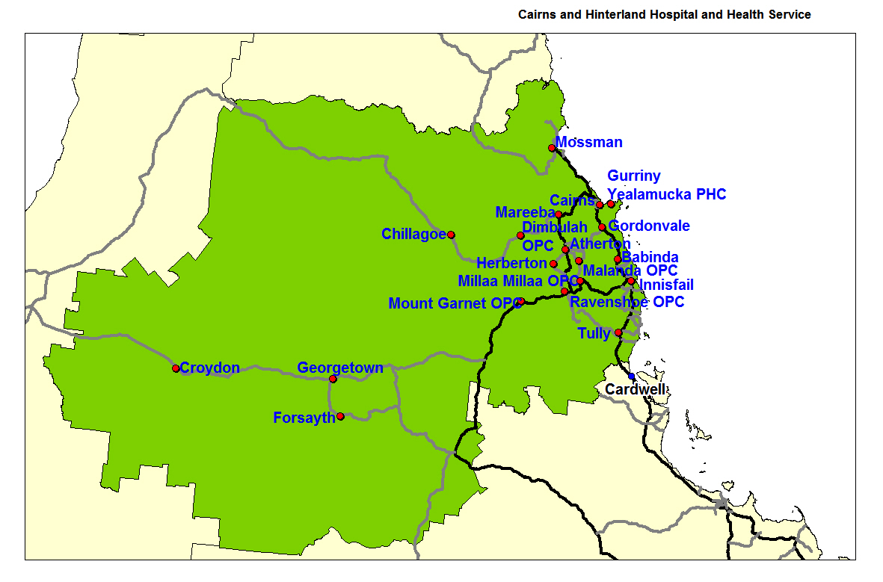
Cairns & Hinterland HSS

Slide 17
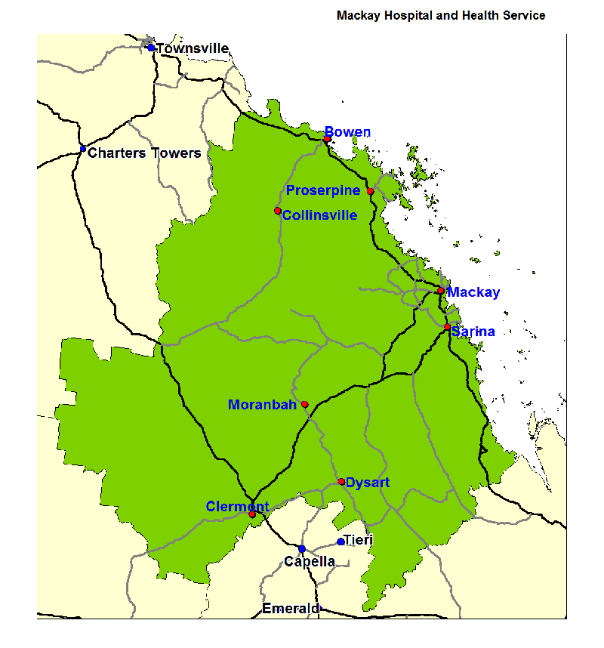
Mackay HSS

Slide 18
BUT…does
DISTANCE
=
DELAY

Slide 19
The KEY word :
Communication

Slide 20
SO……..
Thank you to the speakers
Than you for coming to be part of this event
We look forward to presentations & discussion
Welcome our RACS President ..Tony Sparnon

Slide 21
SO……..
Welcome our RACS President ..Tony Sparnon

