Slide 1

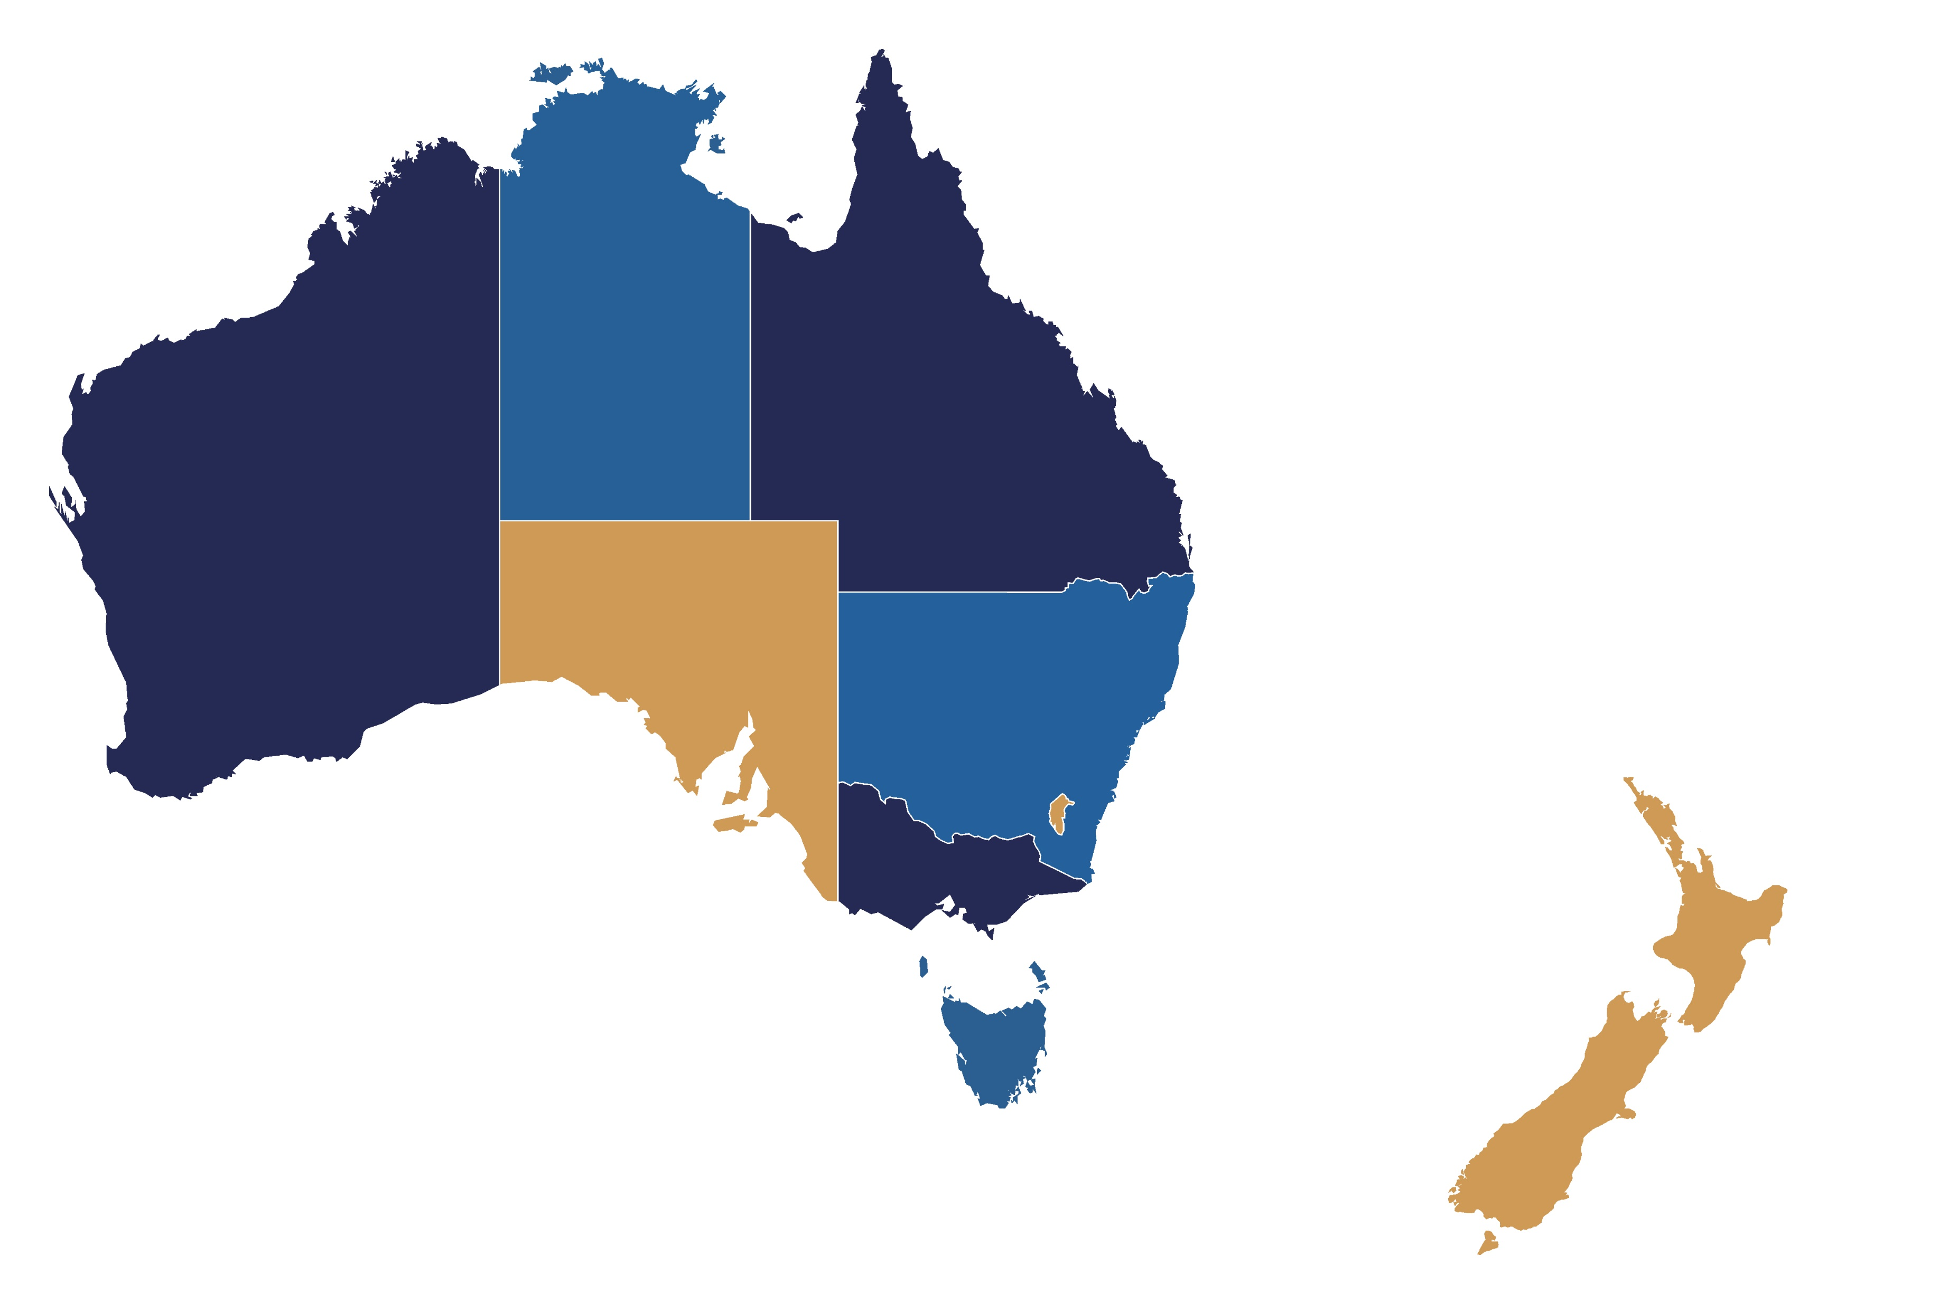
Trauma care verification status in ANZ
as of February 2026
NORTHERN TERRITORY
Royal Darwin Hospital
Alice Springs Hospital
Katherine Hospital
Gove District Hospital
Tennant Creek
QUEENSLAND
Queensland Children’s Hospital
Gold Coast University Hospital
Australian Army – 2nd General Health Battalion
Townsville Hospital
Mackay Base Hospital
Rockhampton Hospital
Nambour Hospital
Royal Brisbane Women’s Hospital
Princess Alexandra Hospital
NEW SOUTH WALES
Liverpool Hospital
John Hunter Hospital
Westmead Hospital
Royal North Shore Hospital
St George Hospital
St Vincent’s Hospital
Children’s Hospital Westmead
Sydney Children’s Hospital
Royal Prince Alfred Hospital
Wollongong Hospital
Tamworth Hospital
Port Macquarie Base Hospital
Coffs Harbour Health Campus
Lismore Base Hospital
Tweed Base Hospital
Orange Base Hospital
Dubbo Base Hospital
Nepean Hospital
Wagga Wagga Hospital
Gosford Hospital
AUSTRALIAN CAPITAL TERRITORY
Canberra Hospital
WESTERN AUSTRALIA
Royal Perth Hospital
Fremantle Hospital
Sir Charles Gairdner Hospital
Princess Margaret Hospital for Children
SOUTH AUSTRALIA
Royal Adelaide Hospital
Flinders Medical Centre
Women’s and Children’s Hospital
Lyell McEwin Hospital
South Australian Trauma System
NEW ZEALAND
Auckland City Hospital
Waikato Hospital
Starship Children’s Hospital
Taranaki Base Hospital
Rotorua Hospital
Tauranga Hospital
Gisborne Hospital
Whakatane Hospital
New Zealand System Review
Central New Zealand Trauma System Review
Wellington, Hutt and Kenepuru Hospitals
Palmerston North Hospital
Hawkes Bay Hospital
Whanganui Hospital
Wairarapa Hospital
VICTORIA
The Alfred Hospital
Royal Melbourne Hospital
Royal Children’s Hospital
TASMANIA
Royal Hobart Hospital
Sites in bold hold current trauma care verification status
States/regions in red have undertaken trauma care system verification

